Slide 1
GitHub to AWS, Step by Step
GitHub
IMS Root
Network account
Every step-through flow from the four explainer pages, in the order they were made
15 flows · 88 steps · click or press → to move through each flow

Slide 2
How the Pipeline Gets Into AWS
1
PART 1 OF 4
New pipeline · Old pipeline
Picture key: signed note = GitHub’s OIDC token · reception copy = the iamr role in IMS Root · master key = AWSControlTowerExecution

Slide 3
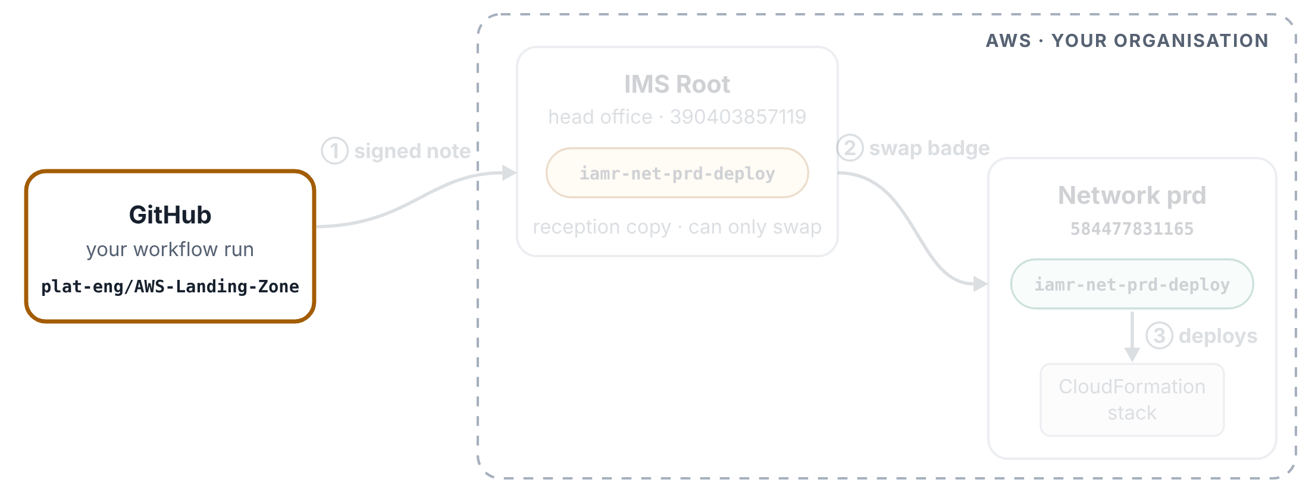
New pipeline: one run
HOW THE PIPELINE GETS INTO AWS
Step 1 of 7
A run of the converted CloudFormation pipeline for NETWORK, signing in through IMS Root.
You start the run
On the Actions tab you choose Run workflow and pick NETWORK. Nothing has touched AWS yet.

Slide 4
New pipeline: one run
HOW THE PIPELINE GETS INTO AWS
Step 2 of 7
A run of the converted CloudFormation pipeline for NETWORK, signing in through IMS Root.
The pipeline works out the badge
The Pick the roles step turns NETWORK into a badge name, iamr-net-prd-deploy, and an account number, 584477831165. It is plain text in the file. No GitHub secret is involved.

Slide 5
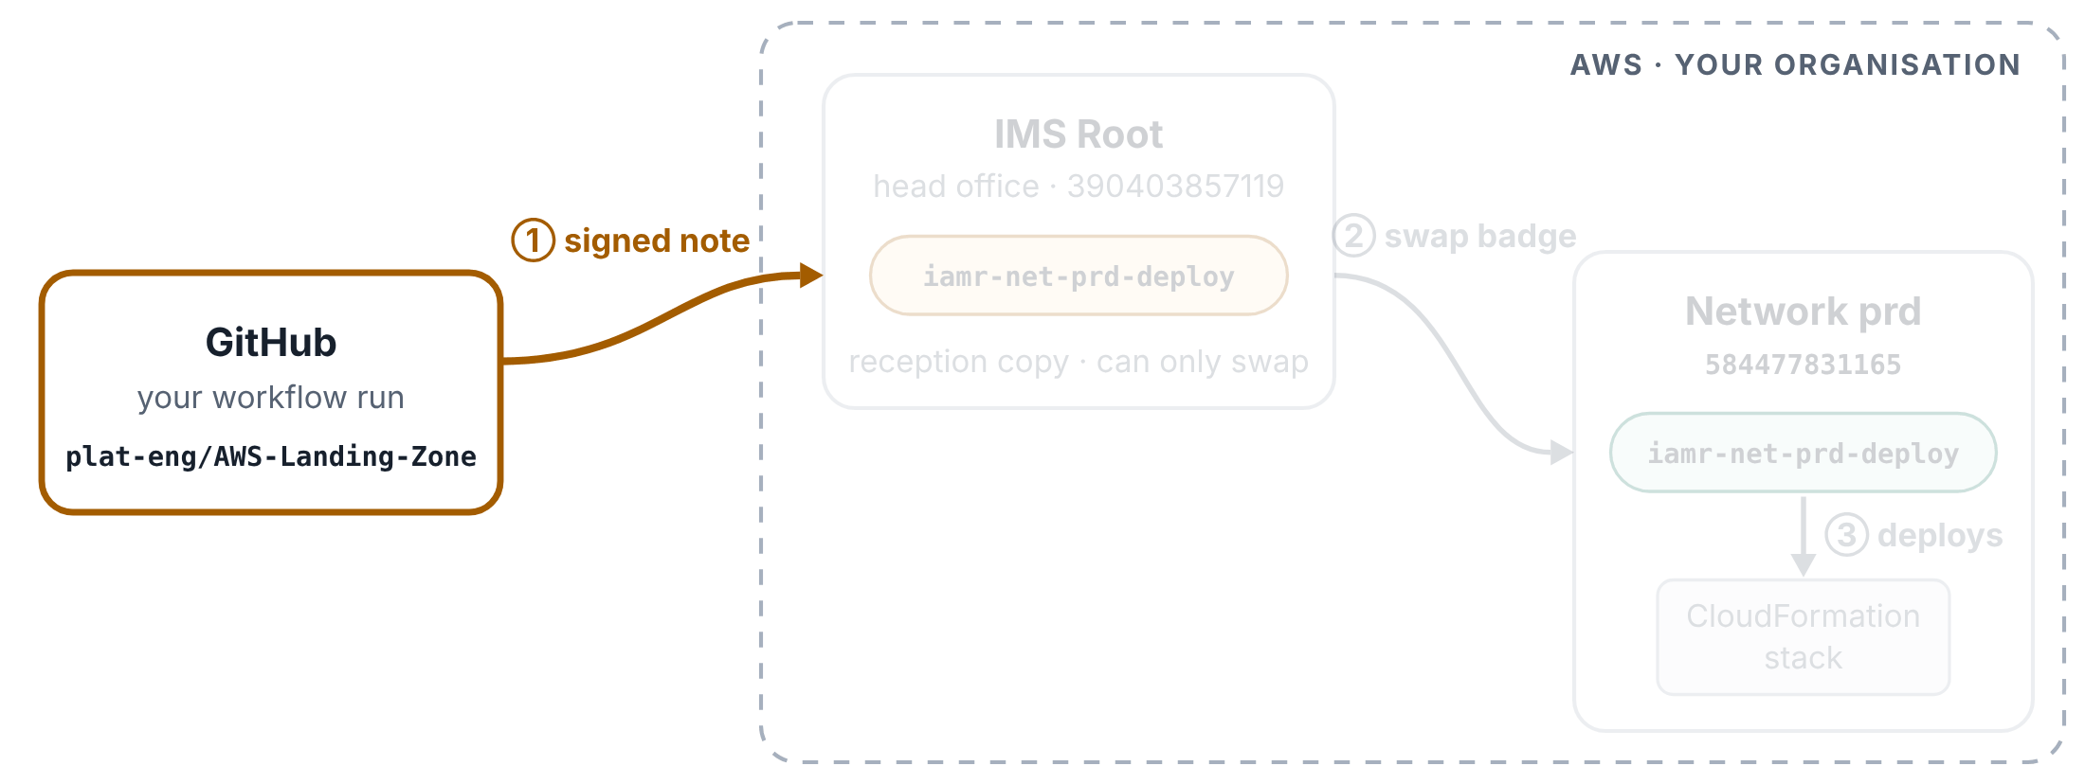
New pipeline: one run
HOW THE PIPELINE GETS INTO AWS
Step 3 of 7
A run of the converted CloudFormation pipeline for NETWORK, signing in through IMS Root.
GitHub writes a signed note
The next step asks GitHub for a short note about this run, and GitHub signs it so AWS can tell it is genuine. This is what OIDC means. The line id-token: write at the top of the file allows the run to ask for the note.

Slide 6
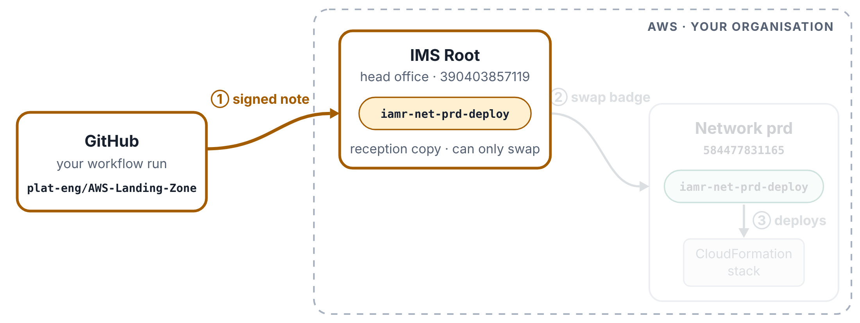
New pipeline: one run
HOW THE PIPELINE GETS INTO AWS
Step 4 of 7
A run of the converted CloudFormation pipeline for NETWORK, signing in through IMS Root.
Hop 1: check in at IMS Root
The Sign in to IMS Root step hands the note to AWS and asks for the reception copy of the badge, in IMS Root. AWS reads that badge’s door list: the note must come from your GitHub, and from AWS-Landing-Zone or ims-app-identity. It does, so the run gets the reception badge for one hour.

Slide 7
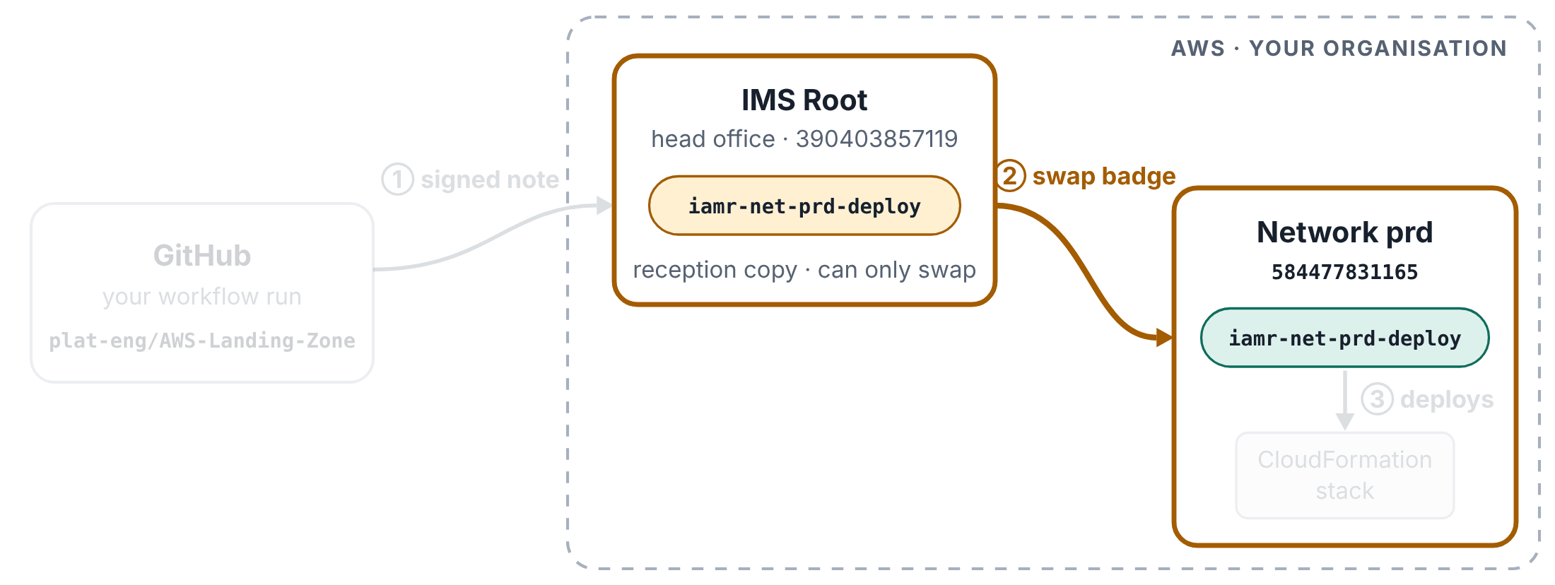
New pipeline: one run
HOW THE PIPELINE GETS INTO AWS
Step 5 of 7
A run of the converted CloudFormation pipeline for NETWORK, signing in through IMS Root.
Hop 2: swap it for the network badge
The Switch to the deploy role step hands in the reception badge and asks for iamr-net-prd-deploy in network prd. AWS checks two things: the reception badge is allowed to make exactly this swap, and the network badge’s door list accepts the reception badge. The run now holds the network badge for one hour.

Slide 8
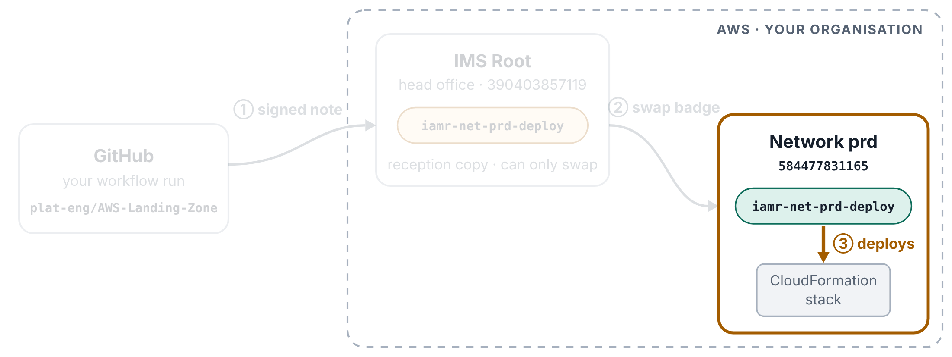
New pipeline: one run
HOW THE PIPELINE GETS INTO AWS
Step 6 of 7
A run of the converted CloudFormation pipeline for NETWORK, signing in through IMS Root.
The work happens in network prd
Every AWS command after this (drift check, change set, deploy) runs as iamr-net-prd-deploy in 584477831165, and Control Tower’s safety rules apply to it.

Slide 9
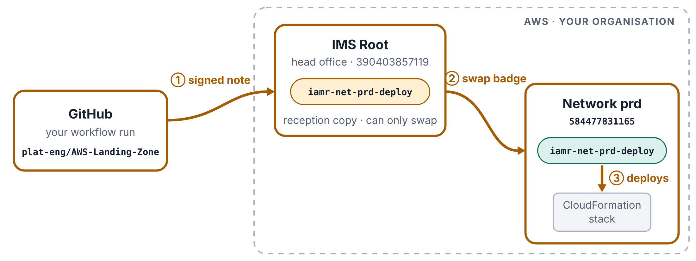
New pipeline: one run
HOW THE PIPELINE GETS INTO AWS
Step 7 of 7
A run of the converted CloudFormation pipeline for NETWORK, signing in through IMS Root.
Each box on the run page repeats both hops
Each box (Prepare, Drift check, Change set, Deploy) starts on a fresh computer, so each one checks in at IMS Root and swaps again. After an hour the badges stop working on their own, and no account badge is kept in a GitHub secret.

Slide 10
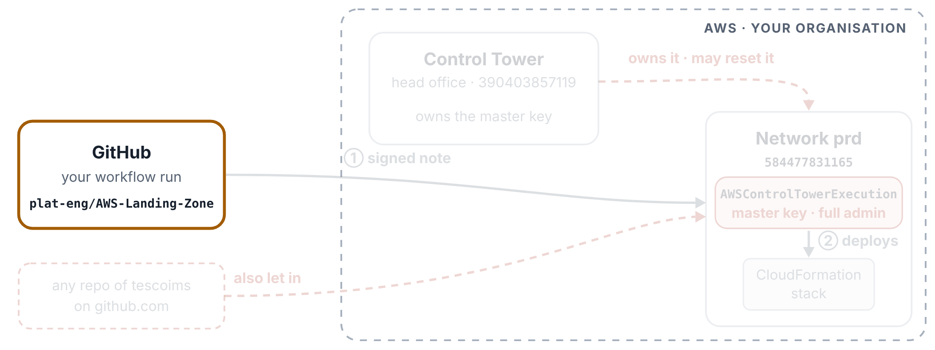
Old pipeline: one run
HOW THE PIPELINE GETS INTO AWS
Step 1 of 6
The same run in the old pipeline, signing in with Control Tower’s master key.
You start the run
You choose Run workflow and pick NETWORK from 18 accounts. Nothing has touched AWS yet.

Slide 11
Old pipeline: one run
HOW THE PIPELINE GETS INTO AWS
Step 2 of 6
The same run in the old pipeline, signing in with Control Tower’s master key.
The pipeline looks up a secret
NETWORK maps to the name of a GitHub secret, NETWORK_SERVICES_ROLE. The value inside that secret is arn:aws:iam::584477831165:role/AWSControlTowerExecution.

Slide 12
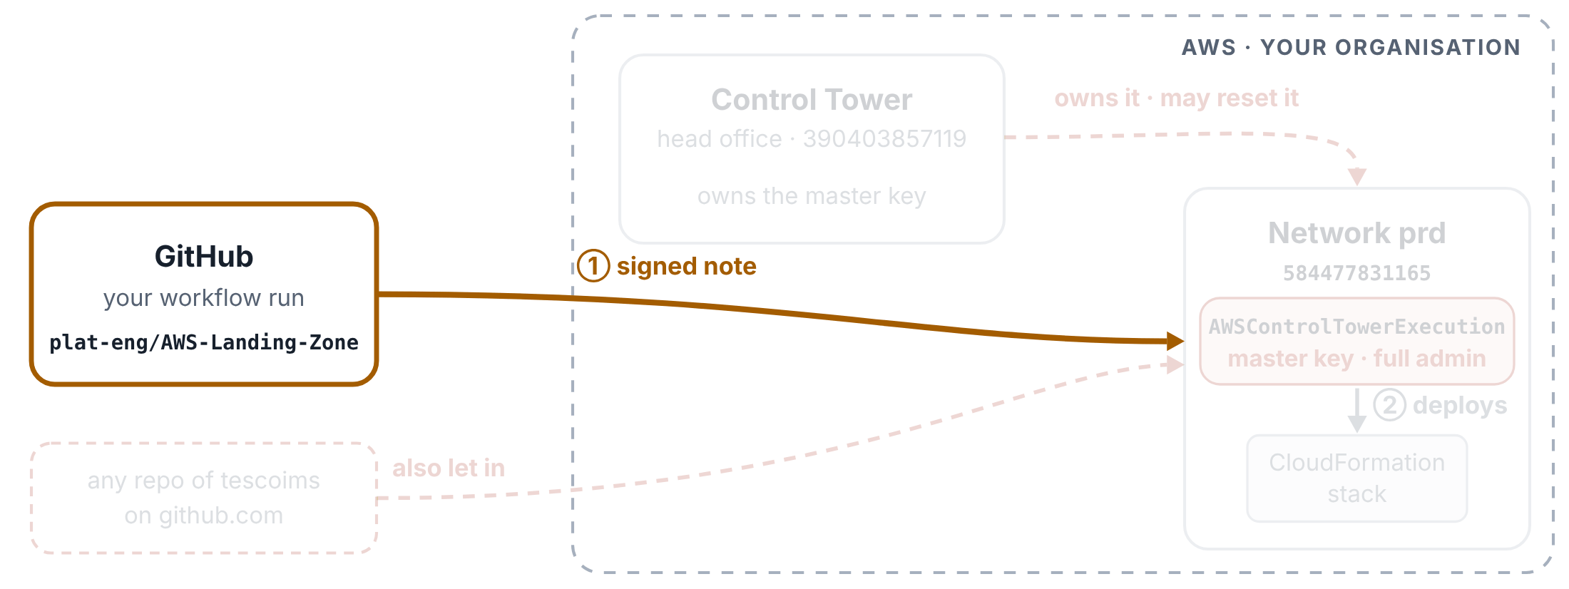
Old pipeline: one run
HOW THE PIPELINE GETS INTO AWS
Step 3 of 6
The same run in the old pipeline, signing in with Control Tower’s master key.
GitHub writes a signed note
Same as the new pipeline: the run asks GitHub for a signed note saying which repo and branch it comes from.

Slide 13
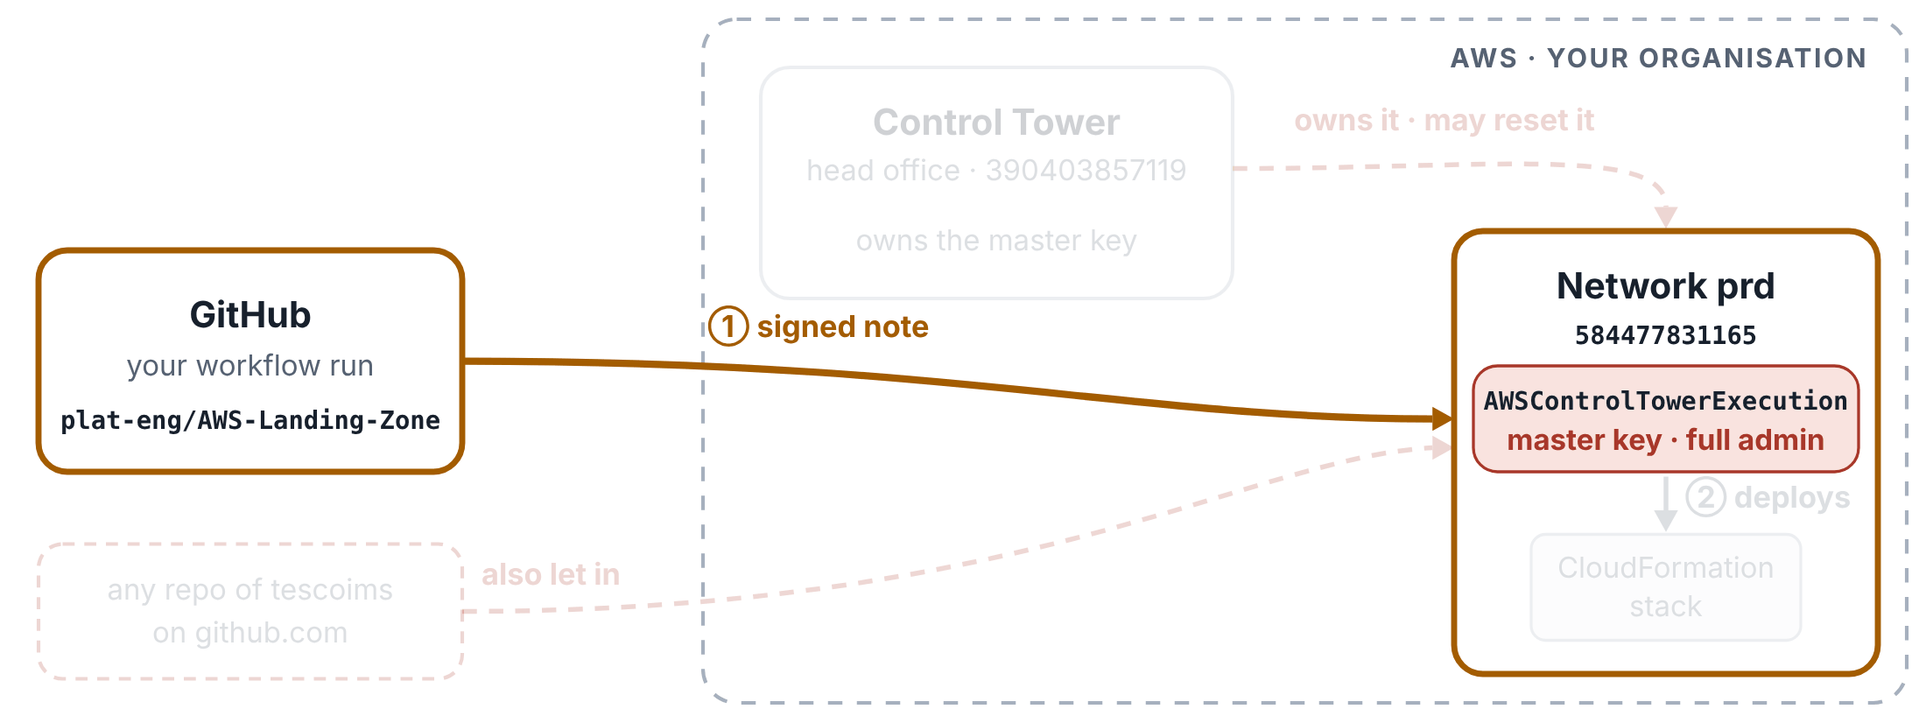
Old pipeline: one run
HOW THE PIPELINE GETS INTO AWS
Step 4 of 6
The same run in the old pipeline, signing in with Control Tower’s master key.
One hop, straight to the master key
The Configure AWS credentials step hands the note to AWS and asks for AWSControlTowerExecution in network prd. Someone added your repo to that key’s door list, so AWS says yes.

Slide 14
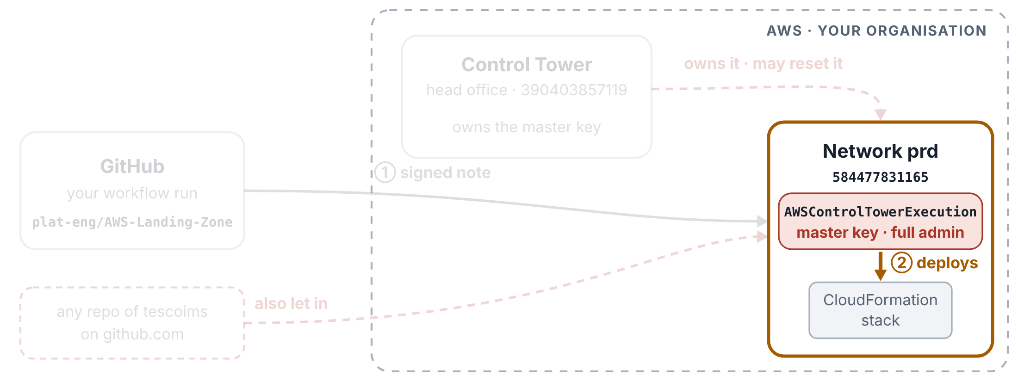
Old pipeline: one run
HOW THE PIPELINE GETS INTO AWS
Step 5 of 6
The same run in the old pipeline, signing in with Control Tower’s master key.
The work runs with the master key
Every AWS command runs as Control Tower’s own master key: it can do everything, and Control Tower’s safety rules make an exception for it.

Slide 15
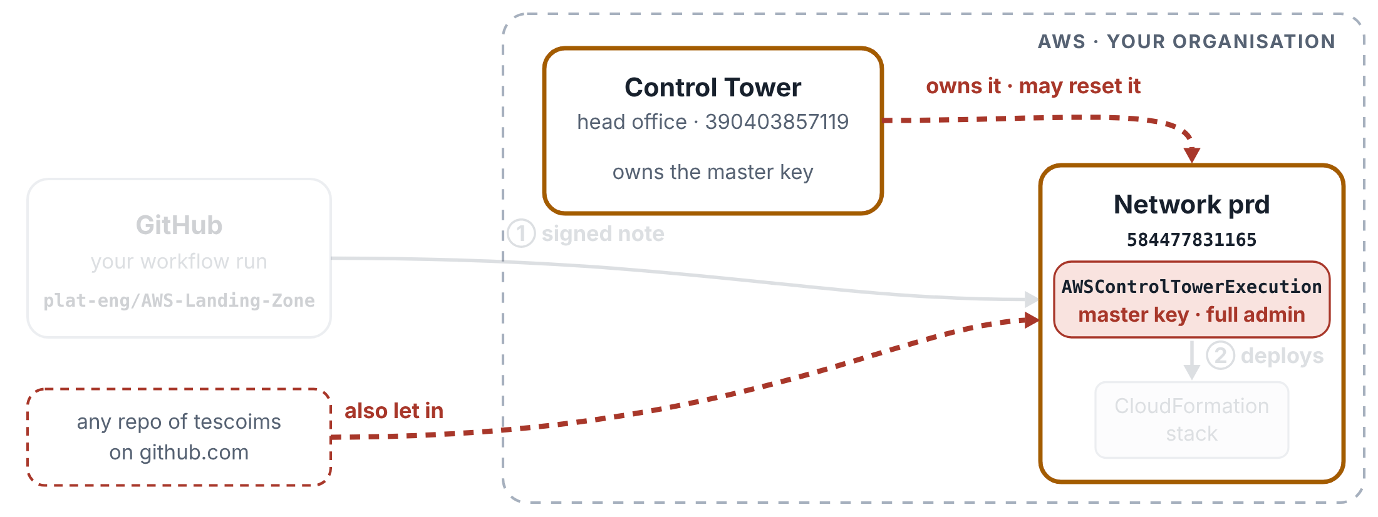
Old pipeline: one run
HOW THE PIPELINE GETS INTO AWS
Step 6 of 6
The same run in the old pipeline, signing in with Control Tower’s master key.
Why the client wants it gone
Control Tower owns this key and can rewrite its door list when the landing zone is updated, which would break the pipeline without warning. The door list also lets in any repo of the tescoims organisation on github.com, from any branch.

Slide 16
Your New Pipelines Explained
2
PART 2 OF 4
CloudFormation pipeline · Trust store pipeline: a manual run and a pull request check
Both pipelines sign in the new way: IMS Root first, then the network account.

Slide 17
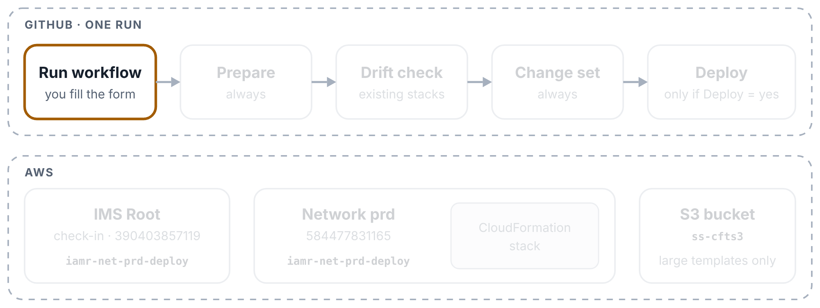
CloudFormation pipeline: one run
YOUR NEW PIPELINES EXPLAINED
Step 1 of 11
One run for NETWORK (network prd). Top row: the boxes on the run page. Bottom row: what each box touches in AWS.
You start the run
In the repo’s Actions tab, pick CloudFormation Stack using S3 as required, click Run workflow and fill in the form, including Deploy and Remove manual changes (both no unless you change them). The run gets a title made from your answers: 🚀 when Deploy = yes, 📝 when it is no.

Slide 18
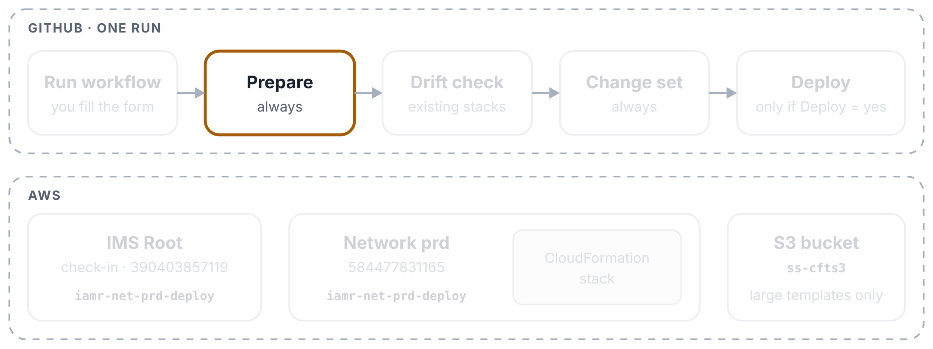
CloudFormation pipeline: one run
YOUR NEW PIPELINES EXPLAINED
Step 2 of 11
One run for NETWORK (network prd). Top row: the boxes on the run page. Bottom row: what each box touches in AWS.
Prepare works out the roles
The first box starts on a fresh GitHub computer and copies your repo. It turns the account you picked into two role names: one in IMS Root and one in the network account. No secret is involved.

Slide 19
CloudFormation pipeline: one run
YOUR NEW PIPELINES EXPLAINED
Step 3 of 11
One run for NETWORK (network prd). Top row: the boxes on the run page. Bottom row: what each box touches in AWS.
Prepare finds your files
It looks in cloudformation/<folder>/ for the template and params.json, and checks the stack name. A template over 51,200 bytes will go through S3 later.

Slide 20
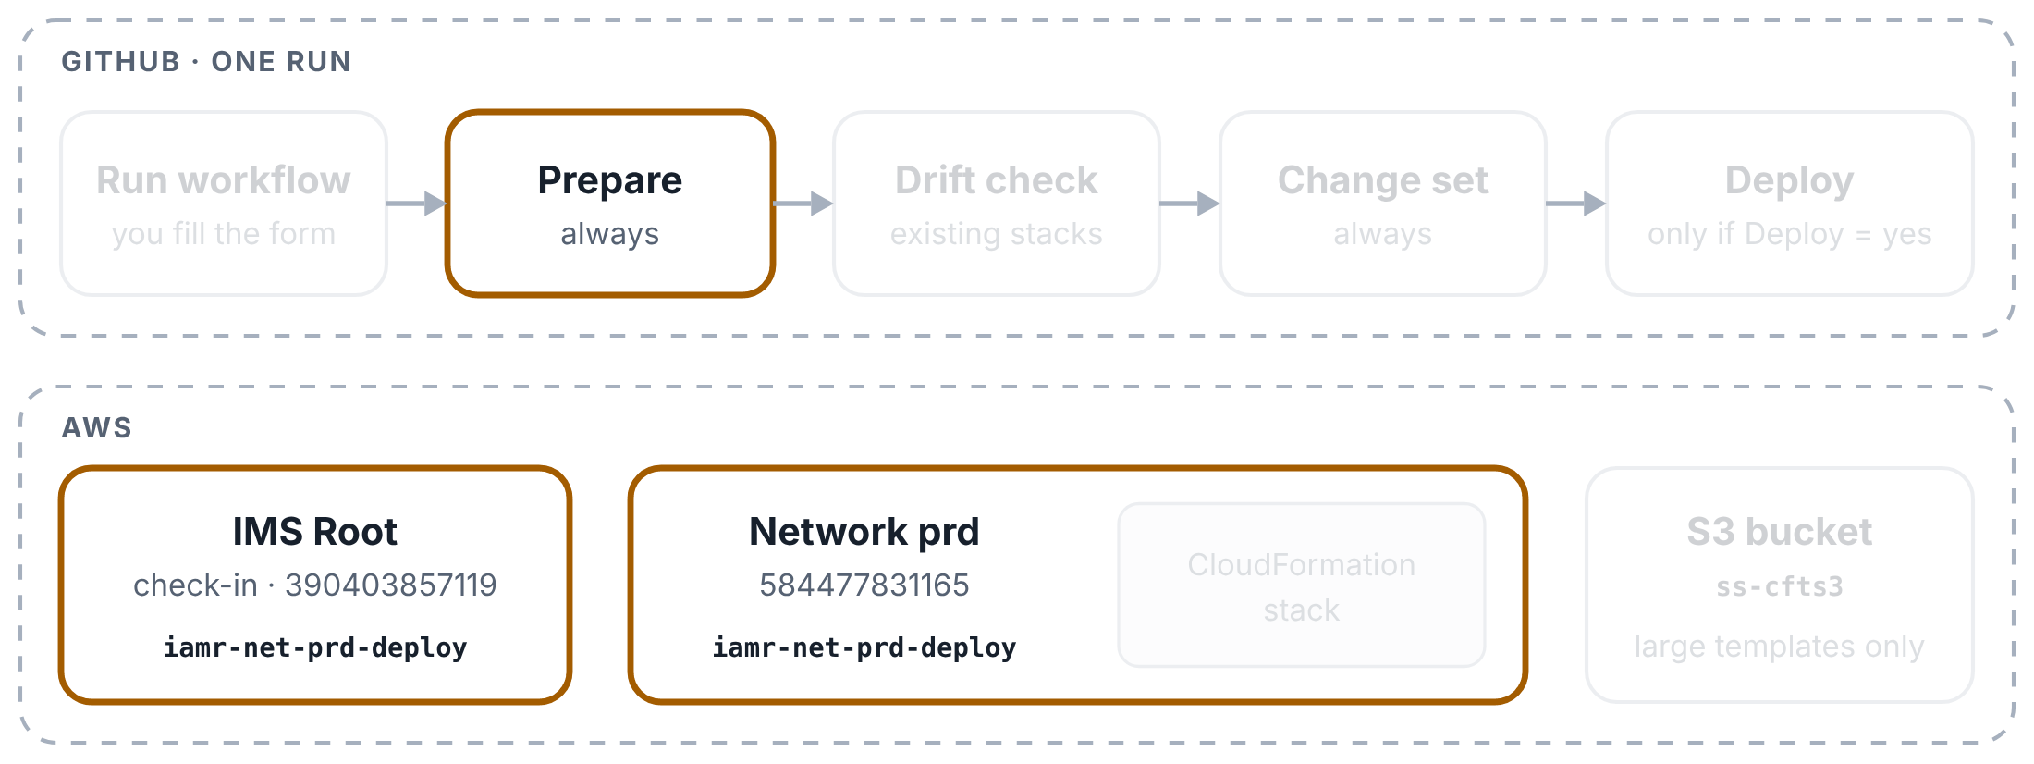
CloudFormation pipeline: one run
YOUR NEW PIPELINES EXPLAINED
Step 4 of 11
One run for NETWORK (network prd). Top row: the boxes on the run page. Bottom row: what each box touches in AWS.
Prepare signs in through IMS Root
Two steps: GitHub’s signed note gets the run into IMS Root, then it swaps that role for the deploy role in network prd. The keys last an hour.

Slide 21
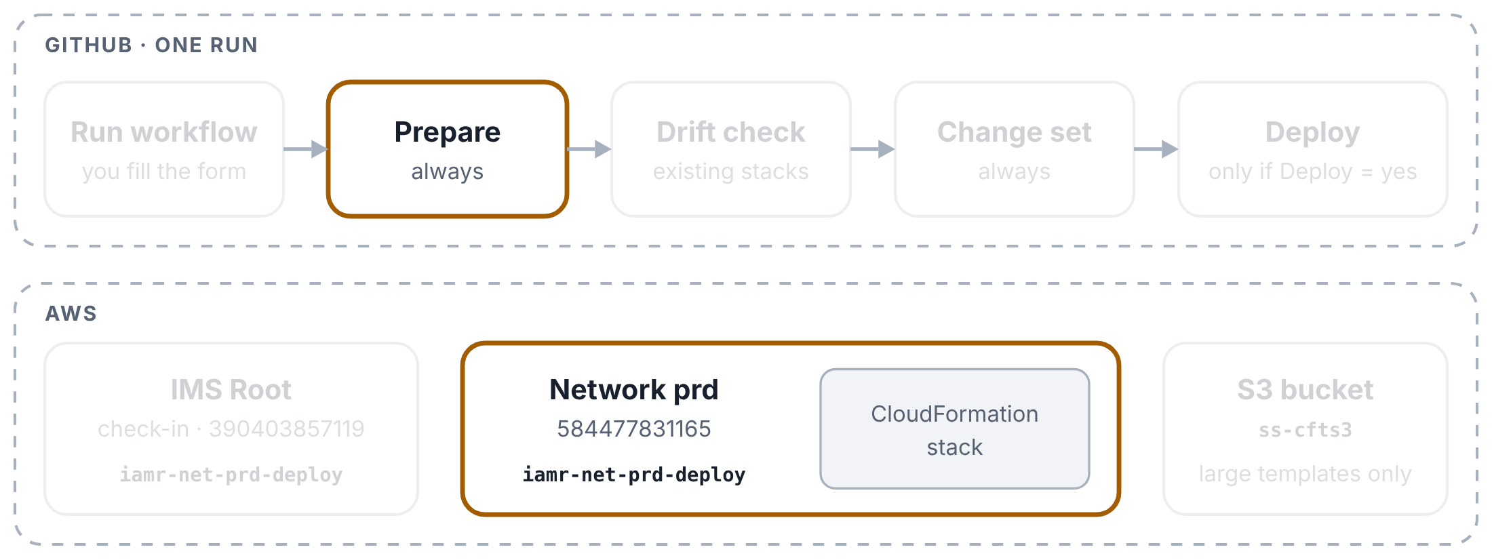
CloudFormation pipeline: one run
YOUR NEW PIPELINES EXPLAINED
Step 5 of 11
One run for NETWORK (network prd). Top row: the boxes on the run page. Bottom row: what each box touches in AWS.
Prepare checks the account and the stack
It makes sure AWS signed it in to the account you picked, then asks CloudFormation about the stack: new → create, existing and settled → drift report, then update, broken or busy → stop with a clear message.

Slide 22
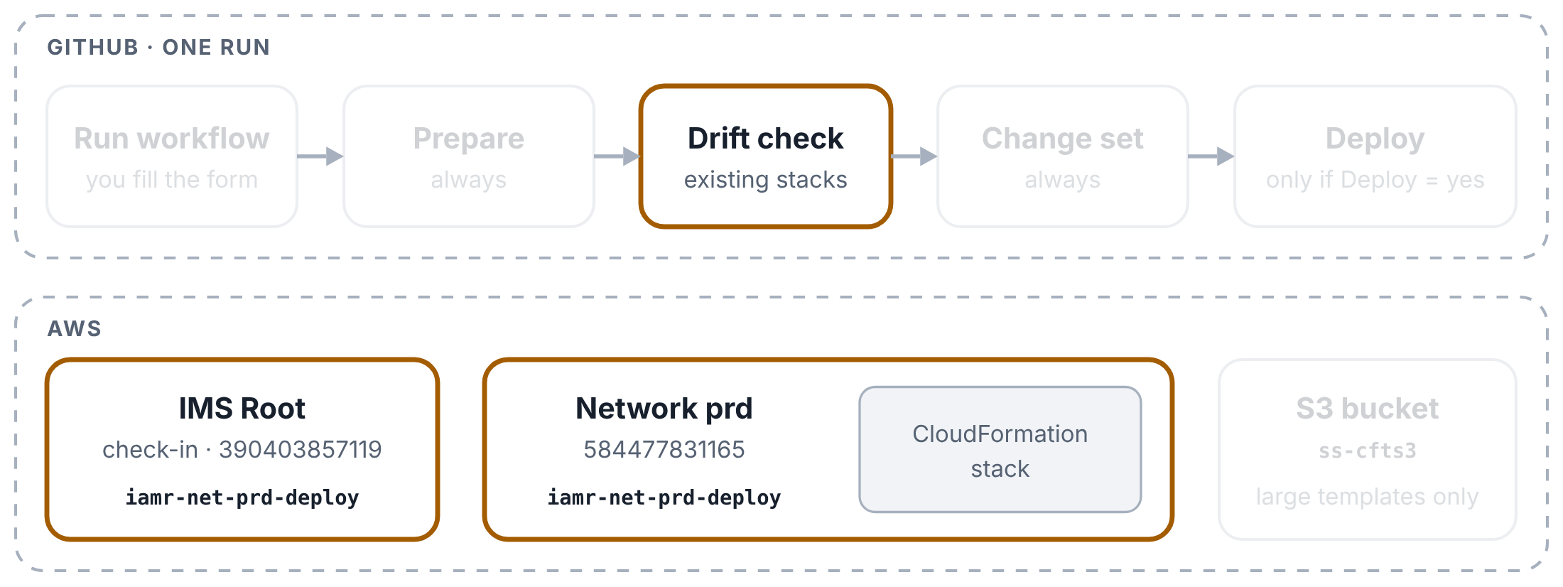
CloudFormation pipeline: one run
YOUR NEW PIPELINES EXPLAINED
Step 6 of 11
One run for NETWORK (network prd). Top row: the boxes on the run page. Bottom row: what each box touches in AWS.
Drift check: information only
The second box signs in again and asks CloudFormation whether anyone changed the stack’s resources by hand. If so, it lists them as a warning, but the run never stops here: it always carries on to the change set. For a new stack this box is grey.

Slide 23
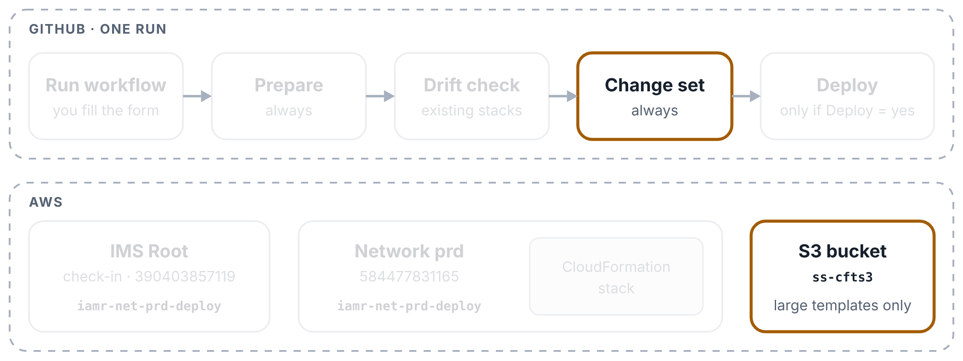
CloudFormation pipeline: one run
YOUR NEW PIPELINES EXPLAINED
Step 7 of 11
One run for NETWORK (network prd). Top row: the boxes on the run page. Bottom row: what each box touches in AWS.
Change set: a large template goes to S3
Only when the template is over 51,200 bytes. The third box signs in with the separate S3 role (still a secret), uploads the template with a short-lived link, and keeps a read link for CloudFormation.

Slide 24
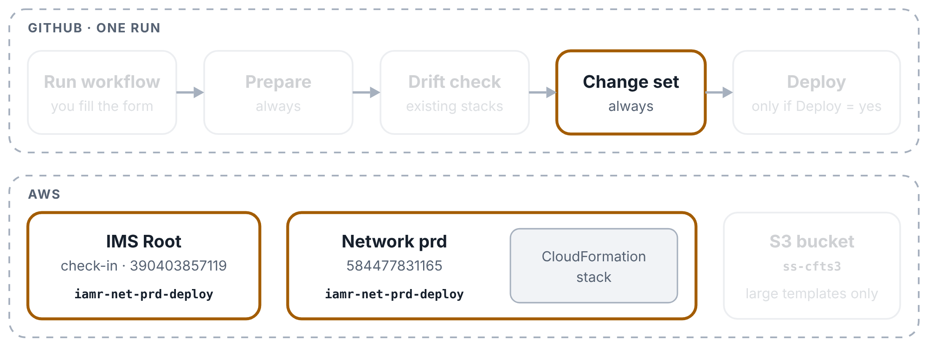
CloudFormation pipeline: one run
YOUR NEW PIPELINES EXPLAINED
Step 8 of 11
One run for NETWORK (network prd). Top row: the boxes on the run page. Bottom row: what each box touches in AWS.
Change set: create it
The box signs in to the network account, checks the template, works out the parameters, and asks CloudFormation for a change set. For an existing stack the change set is drift-aware: it is compared with the live resources, not only the last template. Nothing changes in AWS yet.

Slide 25
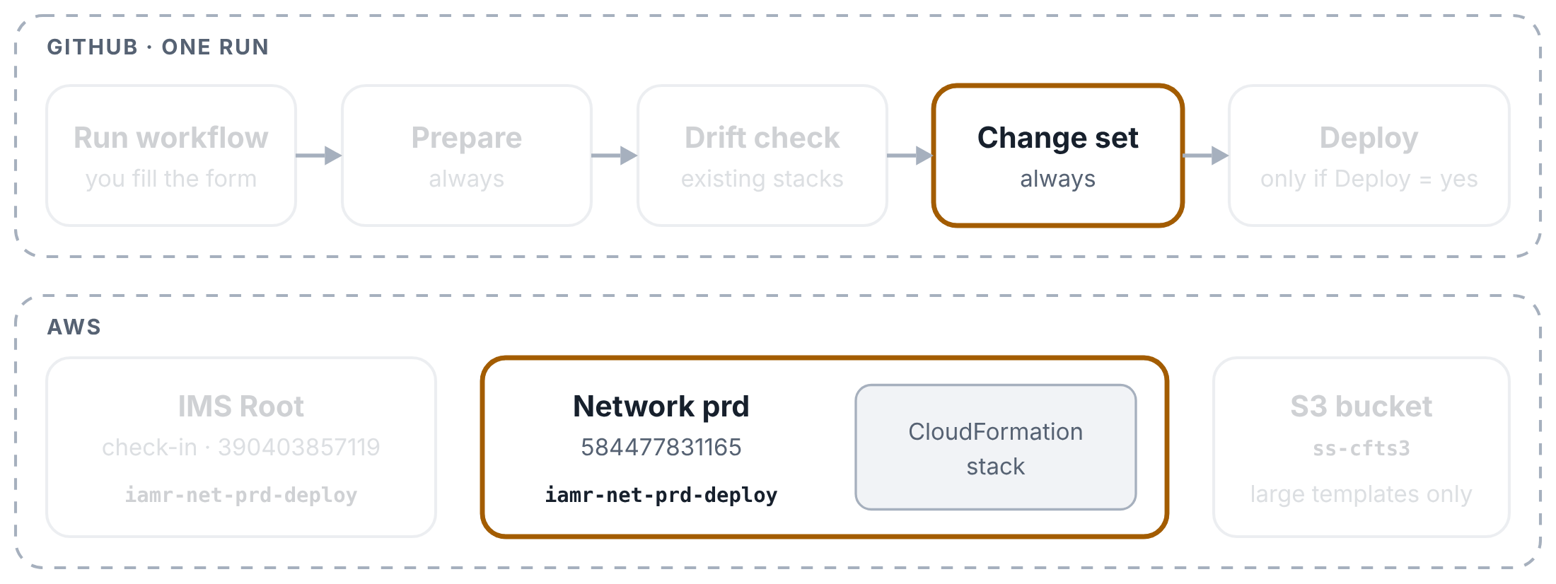
CloudFormation pipeline: one run
YOUR NEW PIPELINES EXPLAINED
Step 9 of 11
One run for NETWORK (network prd). Top row: the boxes on the run page. Bottom row: what each box touches in AWS.
Change set: what will change
The log lists the manual changes that executing would remove (put back to the template), then the template changes it would apply, before → after, with warnings for replacements and removals. With Deploy = no the run ends here: review the change set from the summary’s console link and execute it yourself.

Slide 26
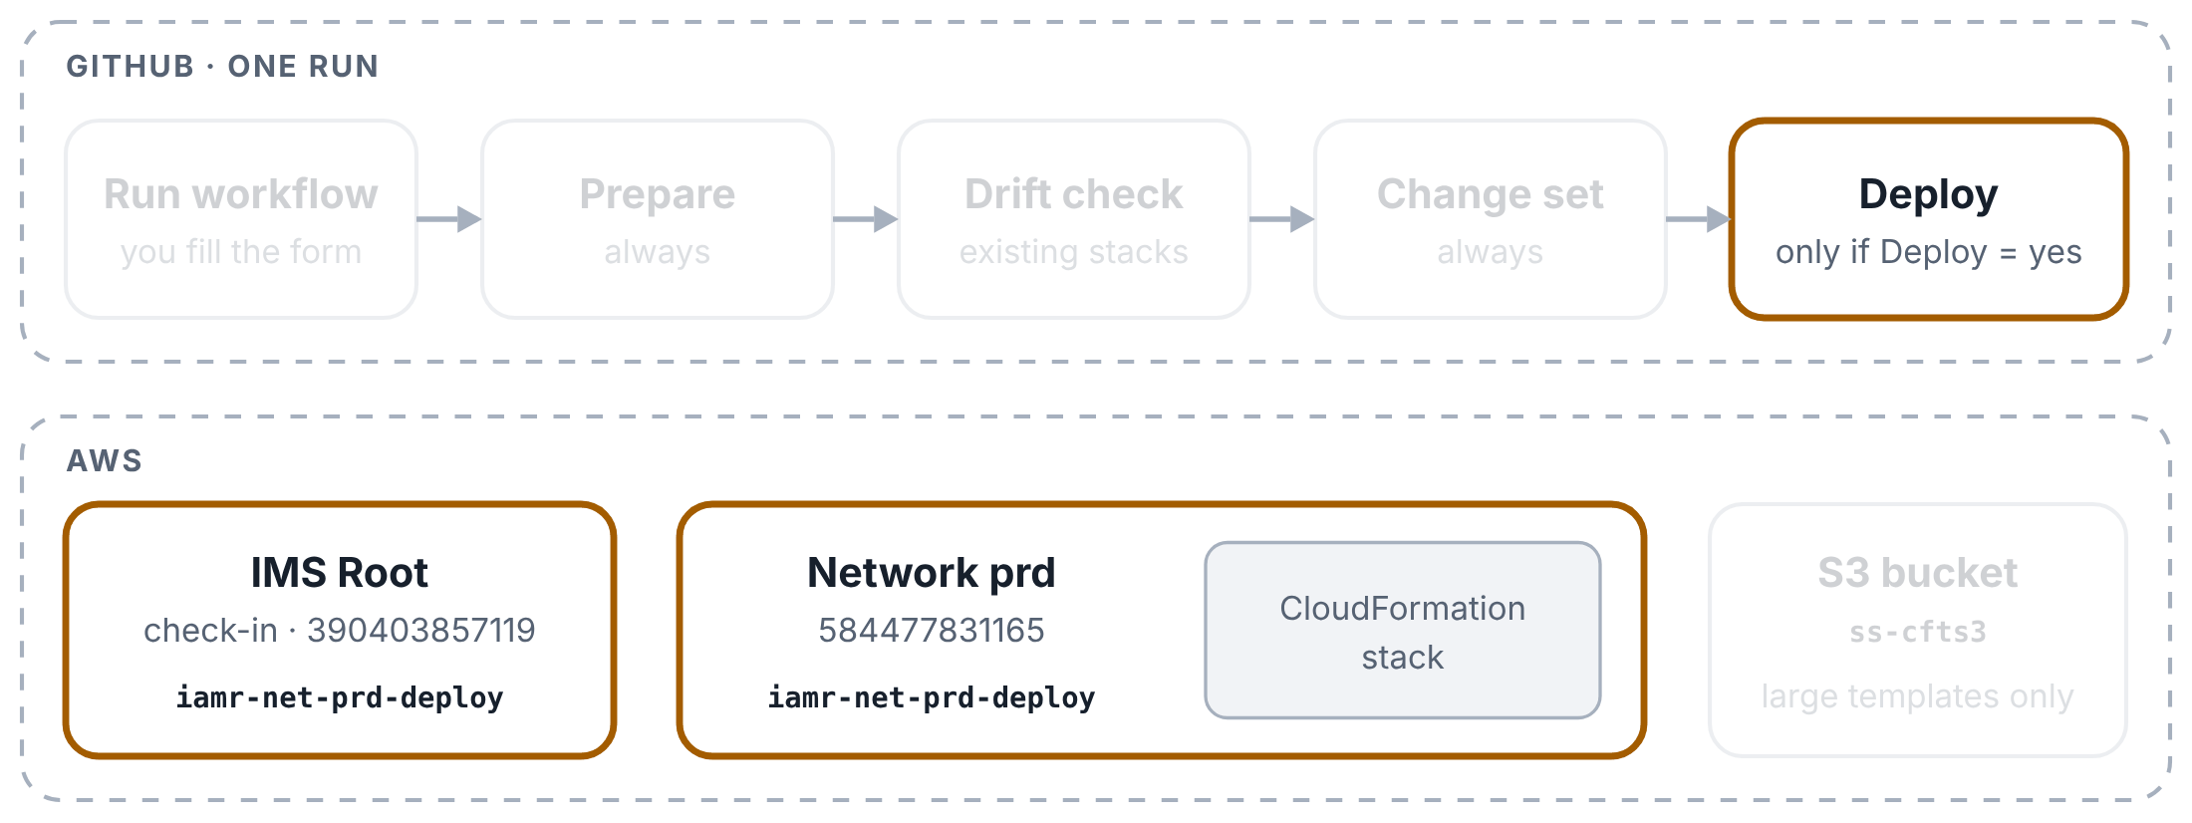
CloudFormation pipeline: one run
YOUR NEW PIPELINES EXPLAINED
Step 10 of 11
One run for NETWORK (network prd). Top row: the boxes on the run page. Bottom row: what each box touches in AWS.
Deploy: execute and follow
Only with Deploy = yes and something to change. If the change set would remove manual changes, this box goes ahead only when Remove manual changes = yes; otherwise it stops before executing. Then it executes the change set and prints the stack’s events every 15 seconds until CloudFormation finishes.

Slide 27
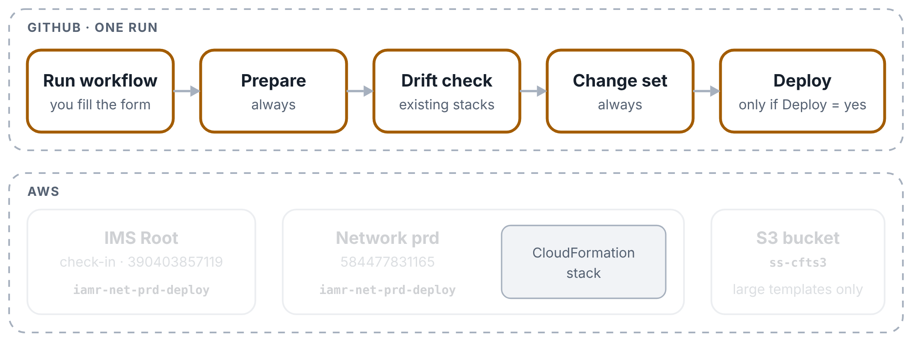
CloudFormation pipeline: one run
YOUR NEW PIPELINES EXPLAINED
Step 11 of 11
One run for NETWORK (network prd). Top row: the boxes on the run page. Bottom row: what each box touches in AWS.
The result
Green boxes and a ✅ Deployed notice, or a red box saying what failed and what to do. If an update fails, CloudFormation puts the stack back as it was. The Summary page keeps the plan, the drift report, the change list and every stack event.

Slide 28
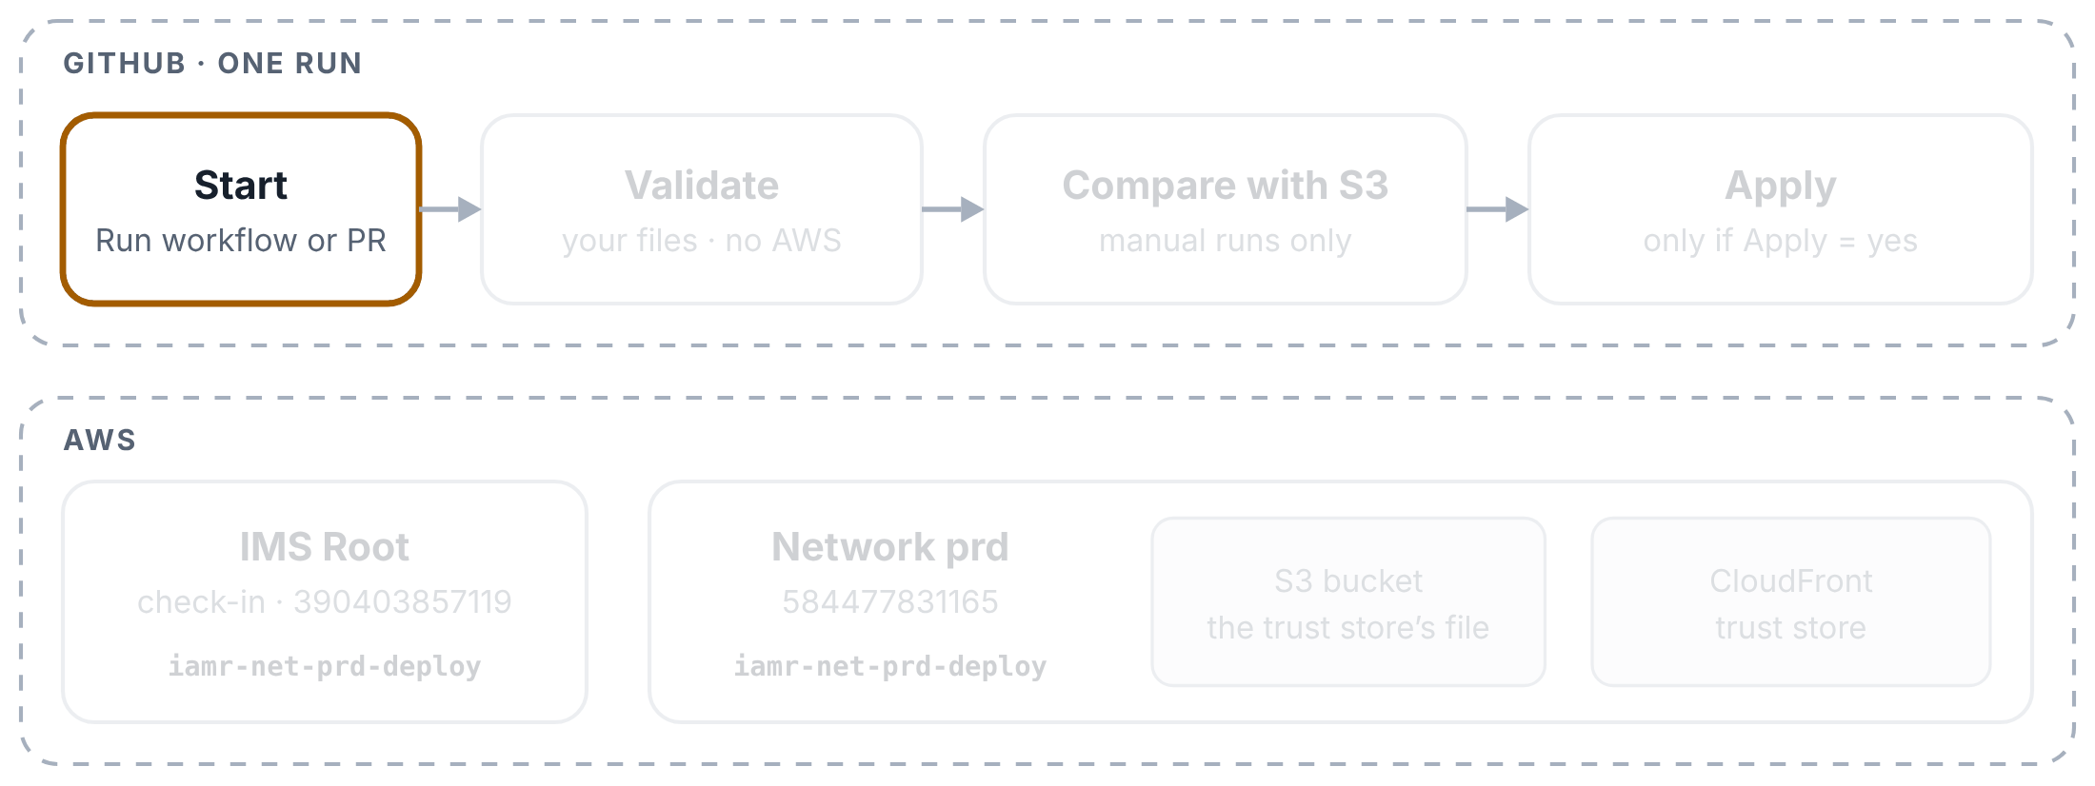
Trust store pipeline: a manual run
YOUR NEW PIPELINES EXPLAINED
Step 1 of 8
A manual run for prd with Apply = yes. ppe and tst work the same way, with their own role and account.
You start the run
Actions tab → Trust store → Run workflow (branch main). Pick the environment, and Apply: no to only compare, yes to put the file live.

Slide 29
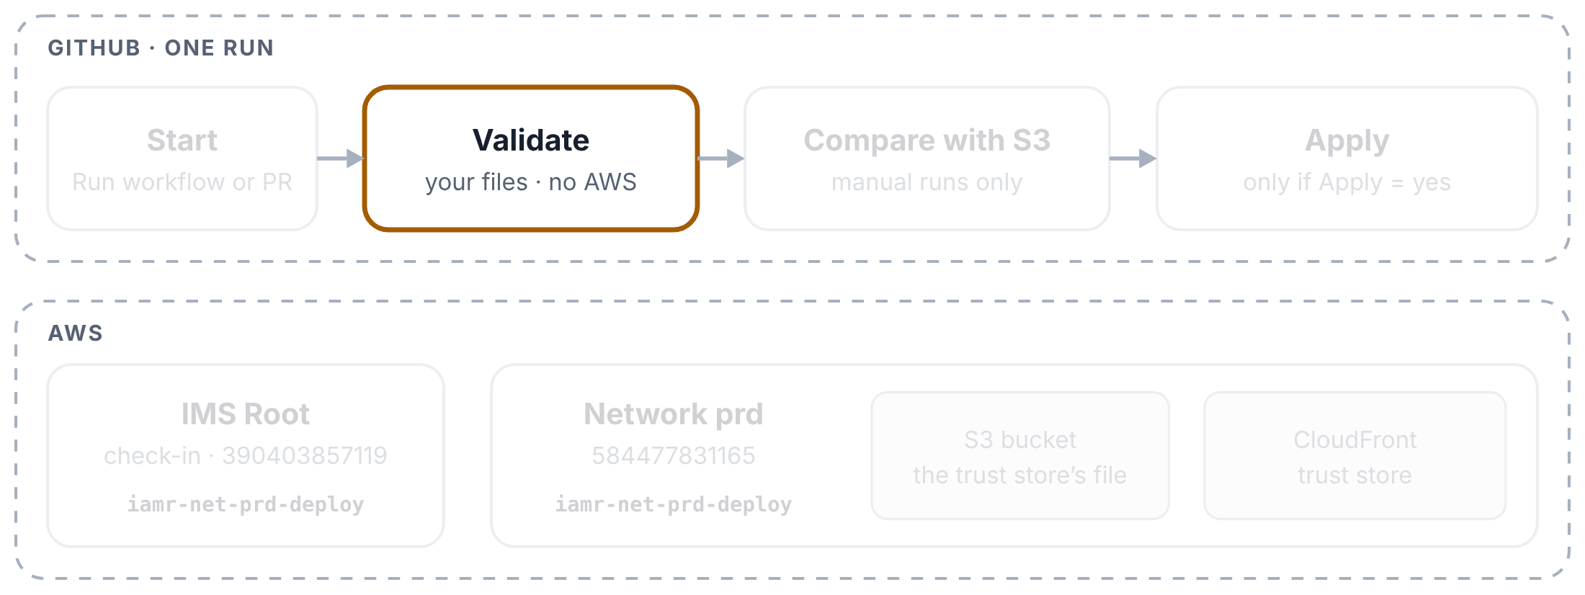
Trust store pipeline: a manual run
YOUR NEW PIPELINES EXPLAINED
Step 2 of 8
A manual run for prd with Apply = yes. ppe and tst work the same way, with their own role and account.
Validate picks the role
The first box works out the network account and the role for that environment, and writes a 🧭 Plan table from truststore.json, the file that says which trust store and which S3 file belong to the environment.

Slide 30
Trust store pipeline: a manual run
YOUR NEW PIPELINES EXPLAINED
Step 3 of 8
A manual run for prd with Apply = yes. ppe and tst work the same way, with their own role and account.
Validate checks the PEM file
It runs the team’s validate-truststore.sh as before, then truststore_update.py checks the file against CloudFront’s rules: real CA certificates, allowed key types, at most 25 certificates, and so on. No AWS yet.

Slide 31
Trust store pipeline: a manual run
YOUR NEW PIPELINES EXPLAINED
Step 4 of 8
A manual run for prd with Apply = yes. ppe and tst work the same way, with their own role and account.
Validate checks truststore.json
Every value must be filled in, and account_id must be the account this environment signs in to. A wrong account stops the run here.

Slide 32
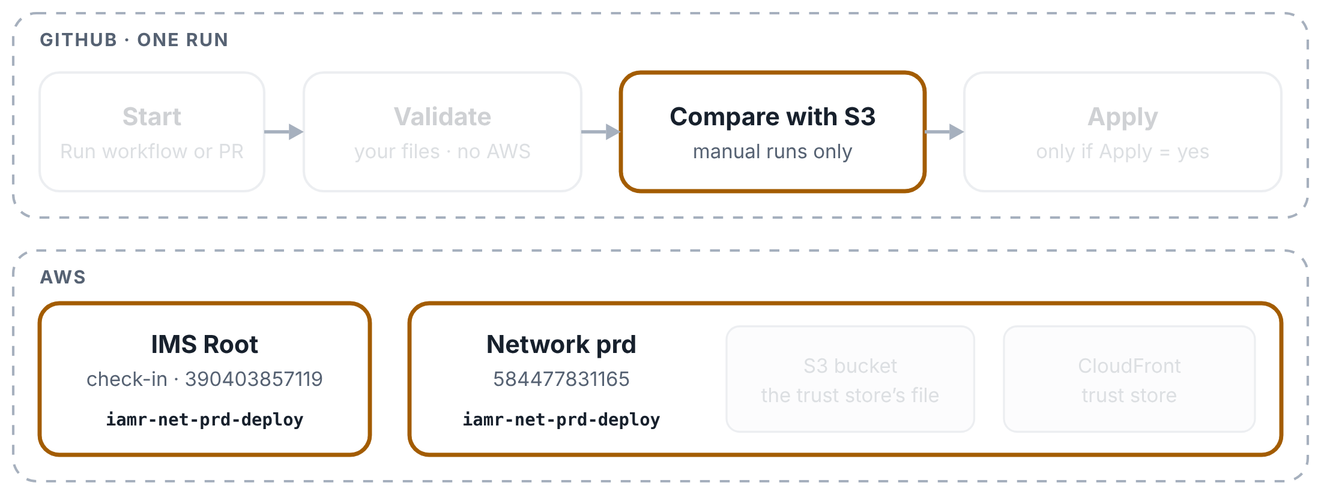
Trust store pipeline: a manual run
YOUR NEW PIPELINES EXPLAINED
Step 5 of 8
A manual run for prd with Apply = yes. ppe and tst work the same way, with their own role and account.
Compare signs in
The second box is the first one allowed to ask GitHub for a signed note. It checks in at IMS Root and swaps for the network account’s deploy role.

Slide 33
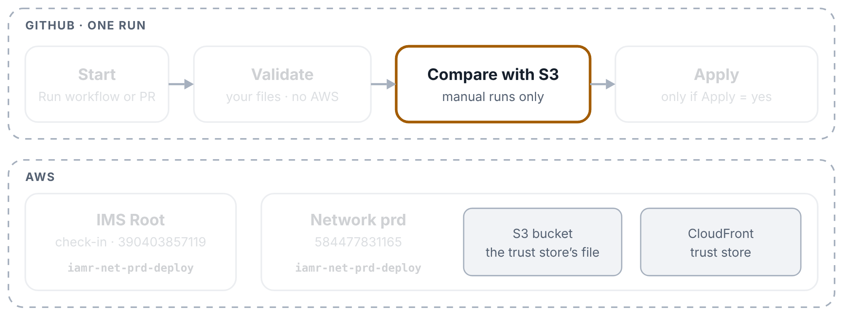
Trust store pipeline: a manual run
YOUR NEW PIPELINES EXPLAINED
Step 6 of 8
A manual run for prd with Apply = yes. ppe and tst work the same way, with their own role and account.
Compare: your file against S3
The script reads the trust store and downloads the file it was built from, then lists the certificates added, removed, replaced and unchanged. It changes nothing. With Apply = no the run ends here.

Slide 34
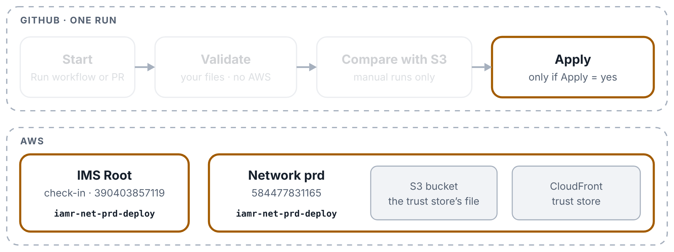
Trust store pipeline: a manual run
YOUR NEW PIPELINES EXPLAINED
Step 7 of 8
A manual run for prd with Apply = yes. ppe and tst work the same way, with their own role and account.
Apply: upload and update
Only with Apply = yes and something to apply. The third box signs in, saves the current S3 file, uploads yours (and reads it back), points the trust store at the new version, and waits until CloudFront says it is active.

Slide 35
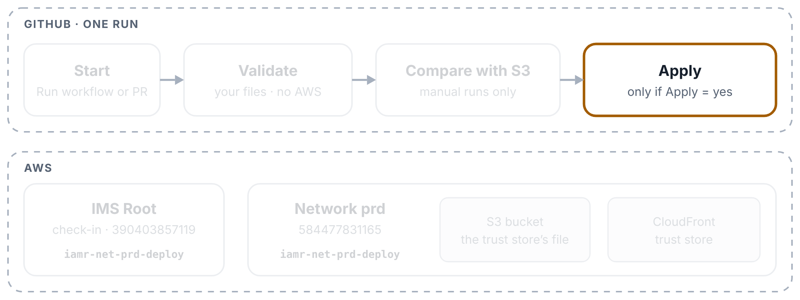
Trust store pipeline: a manual run
YOUR NEW PIPELINES EXPLAINED
Step 8 of 8
A manual run for prd with Apply = yes. ppe and tst work the same way, with their own role and account.
Apply keeps the old file
Even if something failed, the previous S3 file is kept as a download on the run page (an artifact), so you can always put it back.

Slide 36
Trust store pipeline: a pull request check
YOUR NEW PIPELINES EXPLAINED
Step 1 of 4
A pull request check: only the Validate box runs, and nothing touches AWS.
You open a pull request
In a branch, change an environment’s truststore.pem (for example, add a partner’s CA certificate) and open a pull request to main. The check starts by itself.

Slide 37
Trust store pipeline: a pull request check
YOUR NEW PIPELINES EXPLAINED
Step 2 of 4
A pull request check: only the Validate box runs, and nothing touches AWS.
Validate finds what changed
It compares your branch with main to see which environments’ files changed. If only the workflow or a script changed, it checks every environment.

Slide 38
Trust store pipeline: a pull request check
YOUR NEW PIPELINES EXPLAINED
Step 3 of 4
A pull request check: only the Validate box runs, and nothing touches AWS.
Validate checks each changed file
The same checks as a manual run, plus a list of the certificates your pull request adds and removes compared with main. Problems show up on the exact lines of the file in the pull request.

Slide 39
Trust store pipeline: a pull request check
YOUR NEW PIPELINES EXPLAINED
Step 4 of 4
A pull request check: only the Validate box runs, and nothing touches AWS.
Compare and Apply are skipped
They only run for Run workflow, so on a pull request their boxes are grey. A pull request can’t even ask GitHub for a signed note: the workflow gives that permission only to Compare and Apply.

Slide 40
WS2 DNS Pipelines Explained
3
PART 3 OF 4
The Export and Apply loop · Export: one zone, all zones · Apply: preview only, with approval
Both pipelines still sign in the old way, straight to Control Tower’s master key (checked on 31 October 2026).

Slide 41
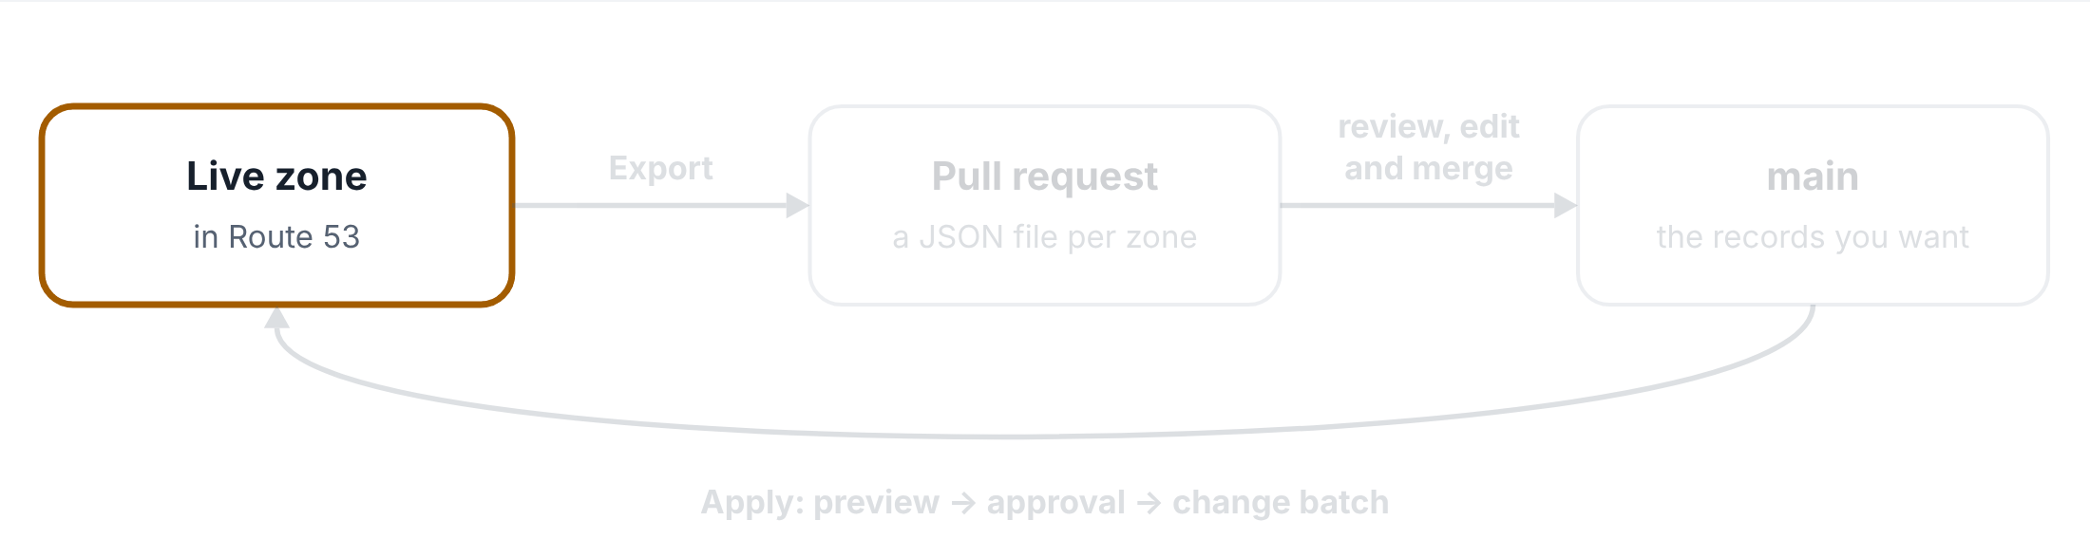
The Export and Apply loop
WS2 DNS PIPELINES EXPLAINED
Step 1 of 4
How the two WS2 pipelines work together: live records into Git, and back again.
The live zone
A Route 53 hosted zone holds the live DNS records.

Slide 42
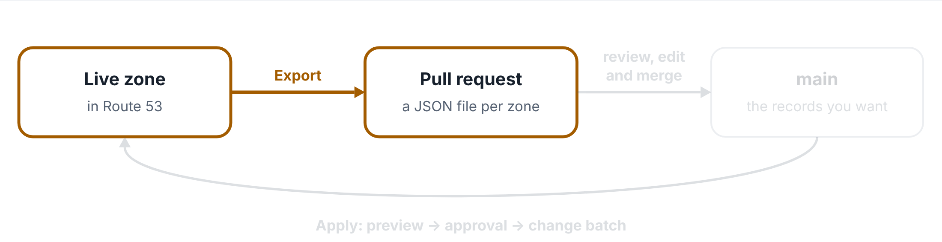
The Export and Apply loop
WS2 DNS PIPELINES EXPLAINED
Step 2 of 4
How the two WS2 pipelines work together: live records into Git, and back again.
Export: live records into a pull request
Export copies the zone’s live records into a JSON file, one per zone, and opens a pull request.

Slide 43
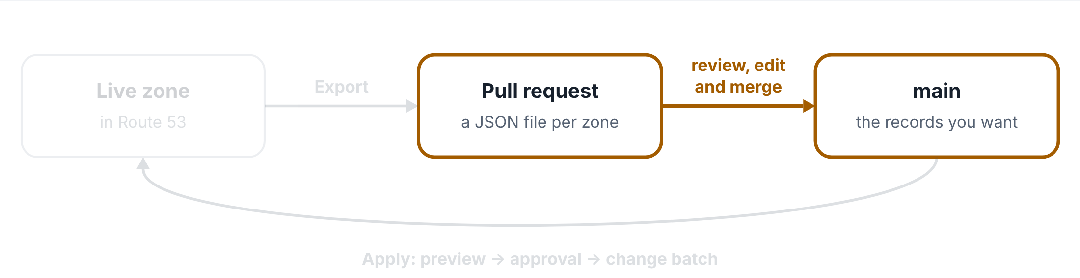
The Export and Apply loop
WS2 DNS PIPELINES EXPLAINED
Step 3 of 4
How the two WS2 pipelines work together: live records into Git, and back again.
Review, edit and merge
The team reviews the file, changes records if needed, and merges it into main. The file on main is the records you want.

Slide 44
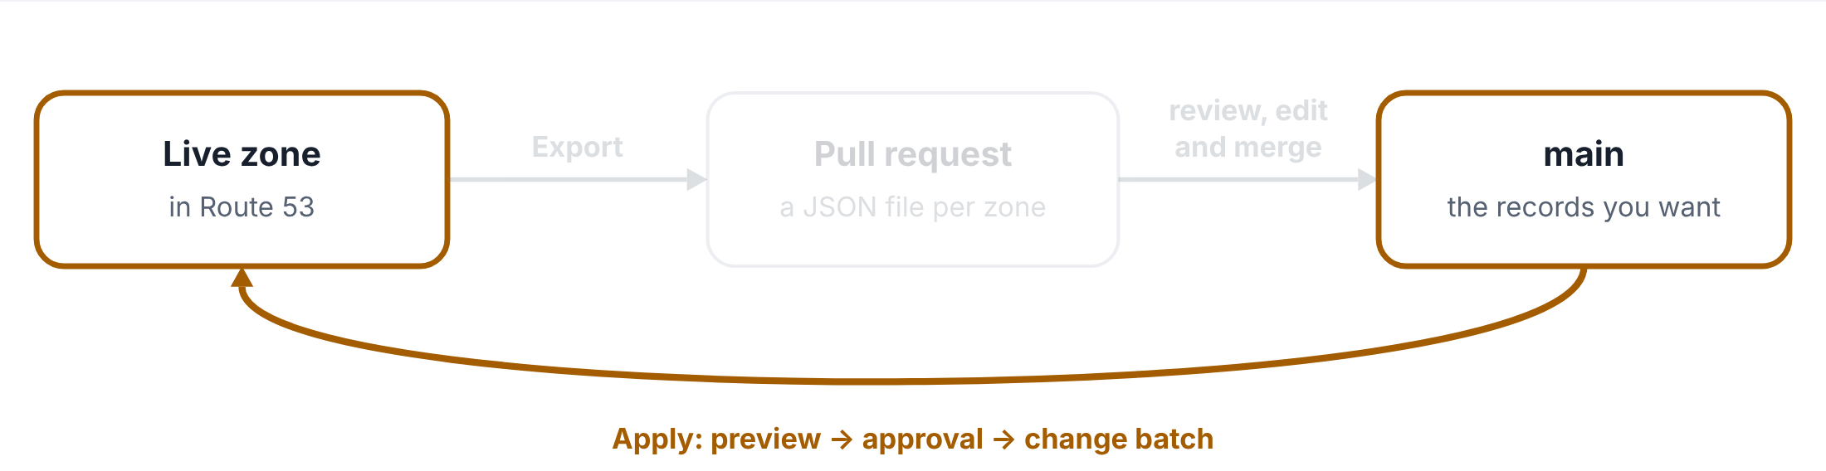
The Export and Apply loop
WS2 DNS PIPELINES EXPLAINED
Step 4 of 4
How the two WS2 pipelines work together: live records into Git, and back again.
Apply: main back to the live zone
Apply compares the file on main with the live zone, shows a preview, waits for approval outside sandbox, then makes the zone match.

Slide 45
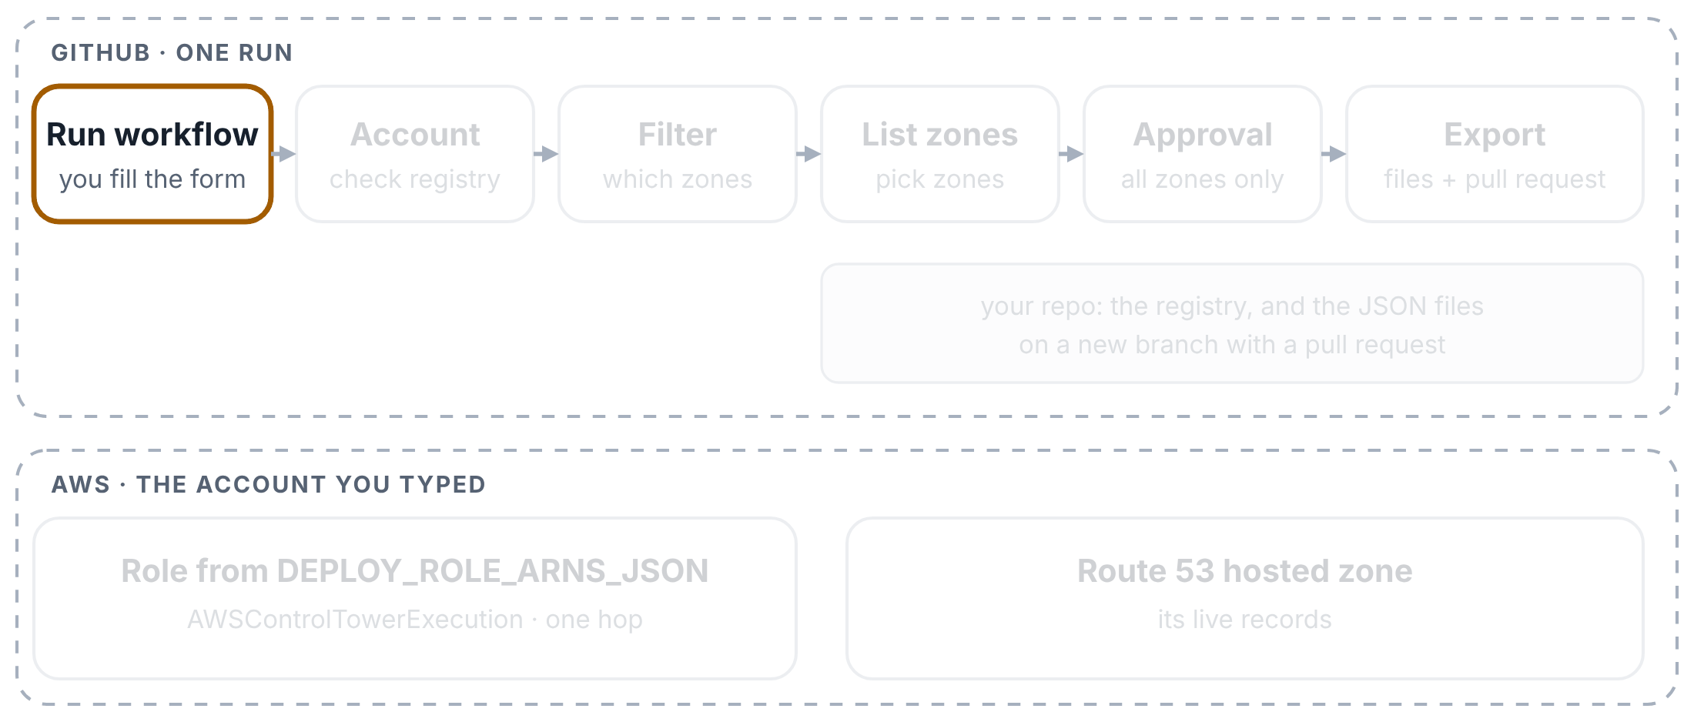
Export: one zone
WS2 DNS PIPELINES EXPLAINED
Step 1 of 9
Exporting one zone, named by its hosted zone ID. Top: GitHub and your repo. Bottom: the AWS account you typed.
You start the run
Actions tab → WS2 - DNS Records Export (batch) → Run workflow. Type the account (for example network-prod) and name one zone: its hosted zone ID, or its stack_id, its name, or the stack that created it.

Slide 46
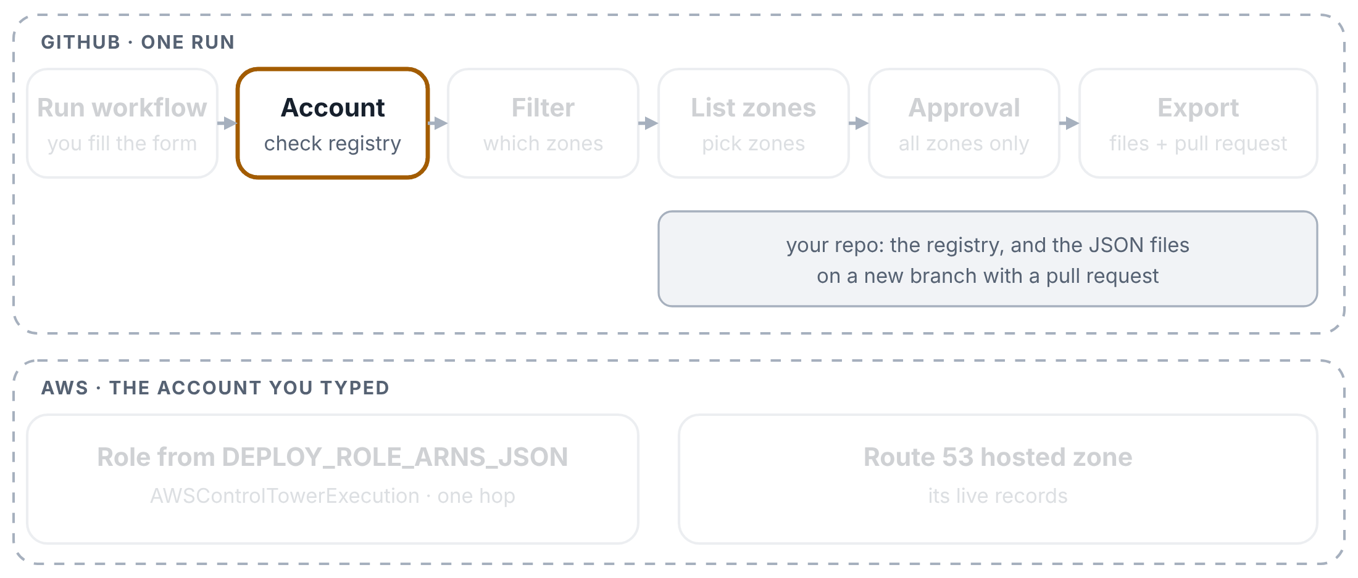
Export: one zone
WS2 DNS PIPELINES EXPLAINED
Step 2 of 9
Exporting one zone, named by its hosted zone ID. Top: GitHub and your repo. Bottom: the AWS account you typed.
The account is checked
The first box reads config/_accounts-registry.yaml from your repo. An account name that isn’t listed stops the run, and the error lists the valid names. No AWS yet.

Slide 47
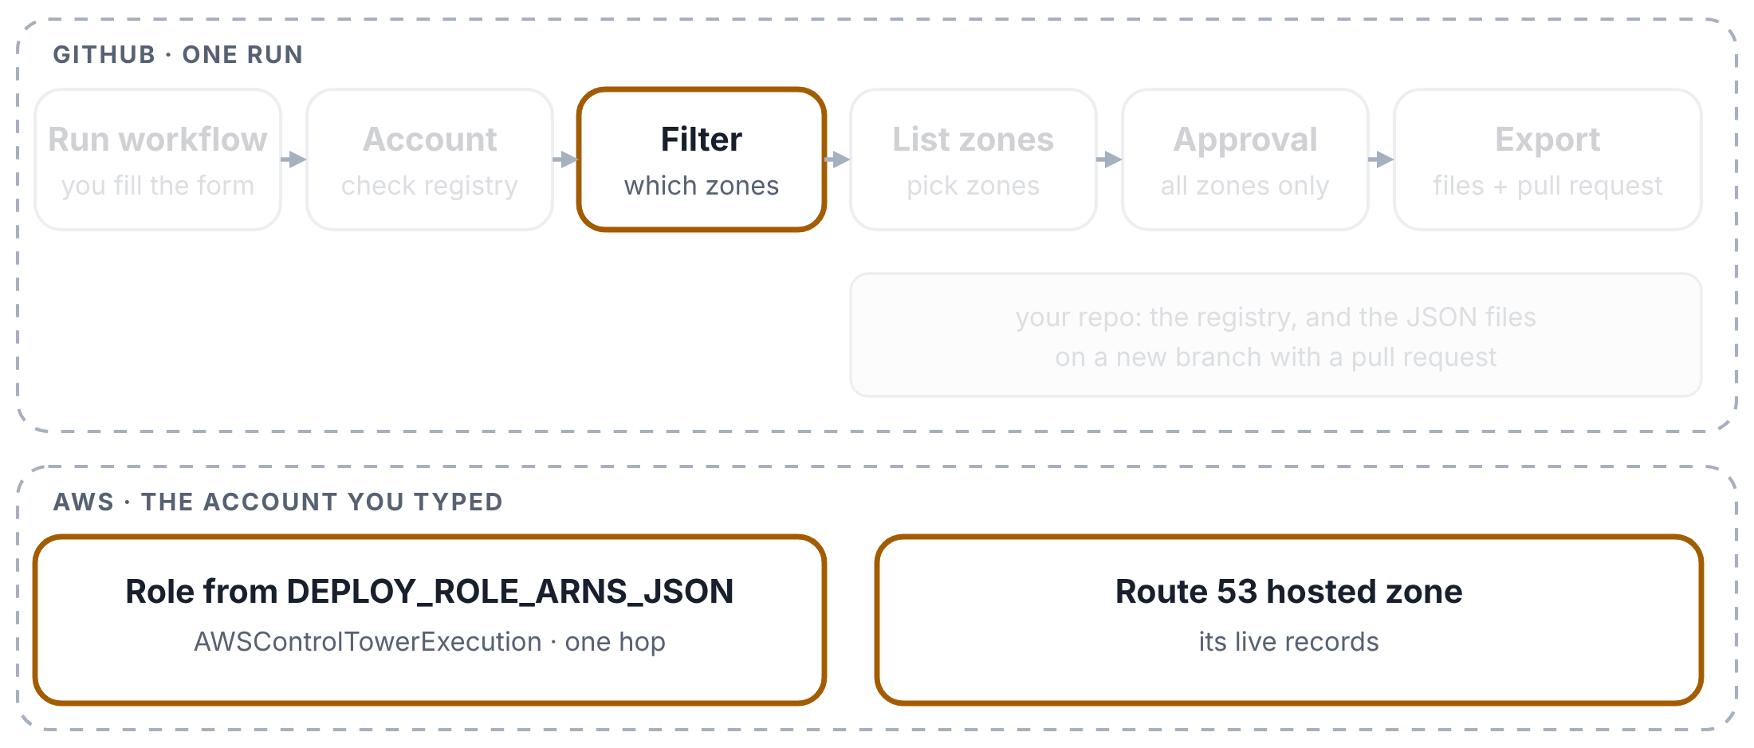
Export: one zone
WS2 DNS PIPELINES EXPLAINED
Step 3 of 9
Exporting one zone, named by its hosted zone ID. Top: GitHub and your repo. Bottom: the AWS account you typed.
The zone ID is looked up
Because you gave a zone ID, the second box signs in (the old way) and asks Route 53 for the zone’s name. It turns the name into the stack_id that the file will be named after.

Slide 48
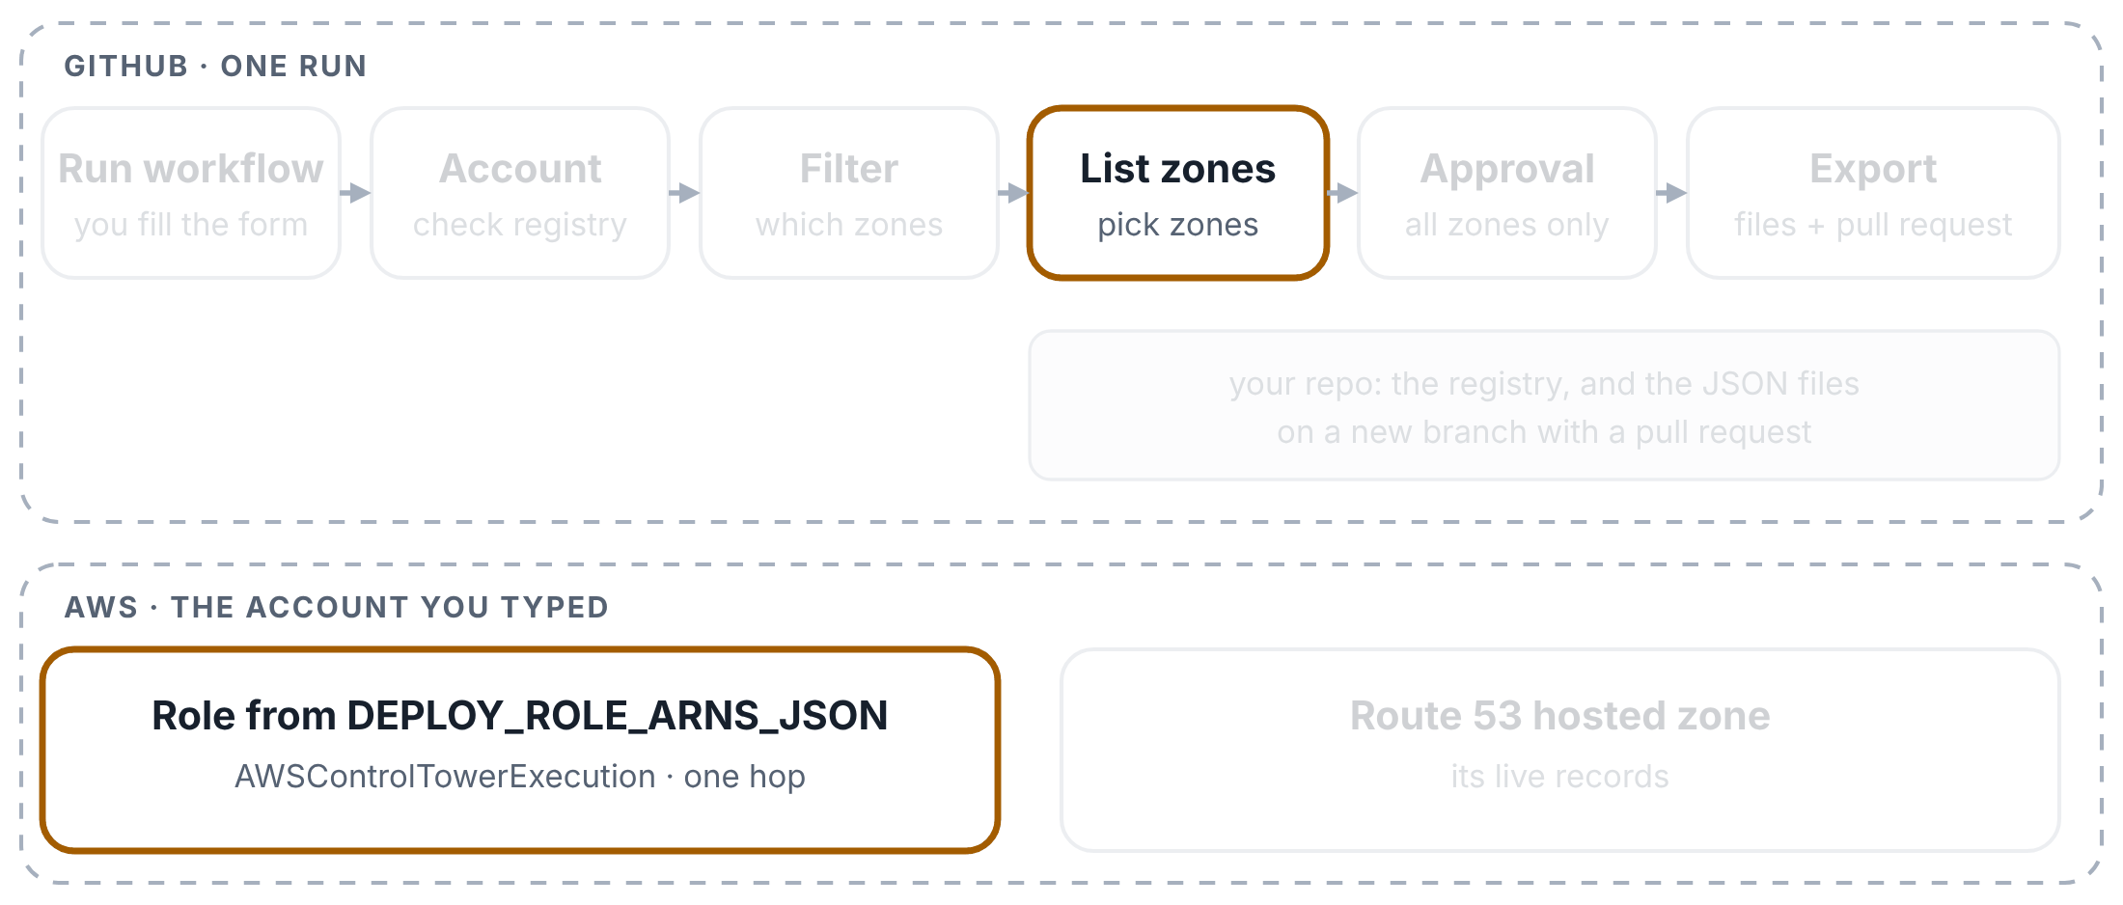
Export: one zone
WS2 DNS PIPELINES EXPLAINED
Step 4 of 9
Exporting one zone, named by its hosted zone ID. Top: GitHub and your repo. Bottom: the AWS account you typed.
List zones signs in
The third box looks up the role for your account in DEPLOY_ROLE_ARNS_JSON and signs straight in to that account, in one step.

Slide 49
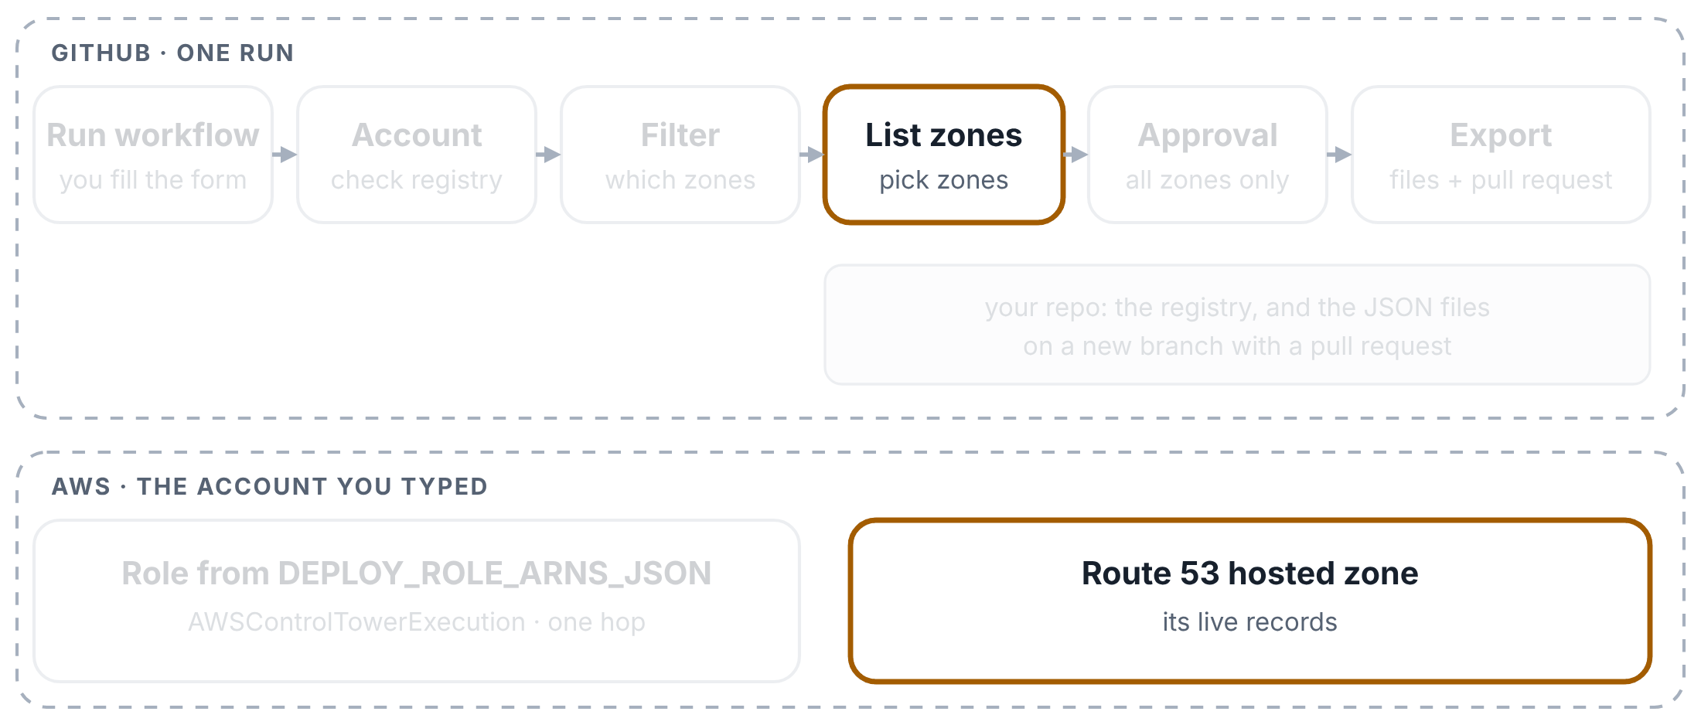
Export: one zone
WS2 DNS PIPELINES EXPLAINED
Step 5 of 9
Exporting one zone, named by its hosted zone ID. Top: GitHub and your repo. Bottom: the AWS account you typed.
List zones picks the zone
It lists every zone in the account, gives each one a stack_id, and picks yours. The choice goes to the next box as a small file (an artifact).

Slide 50
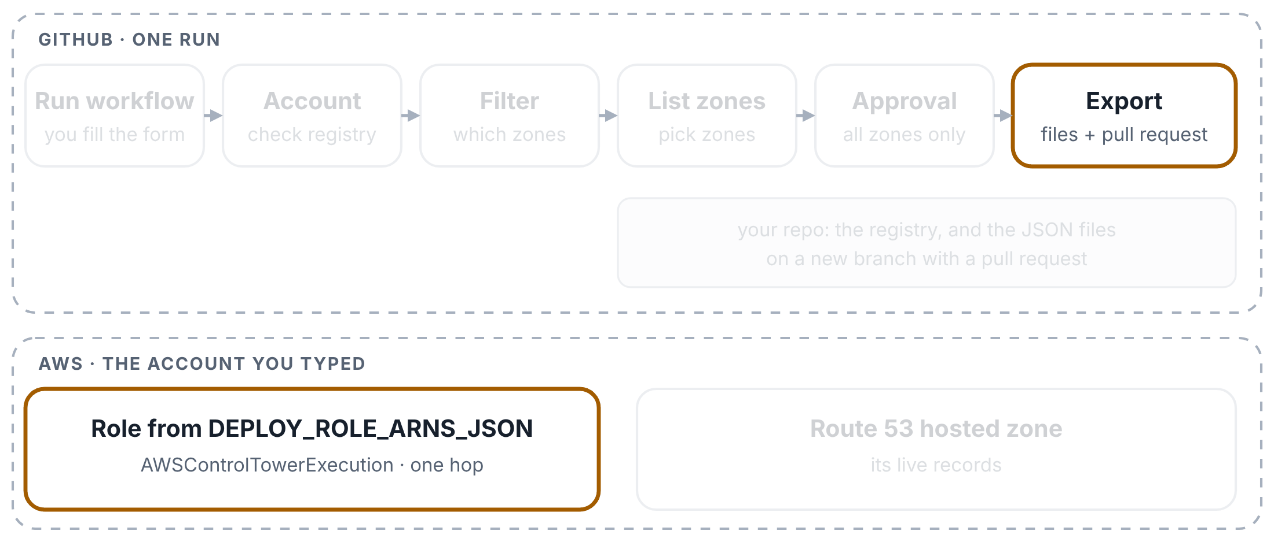
Export: one zone
WS2 DNS PIPELINES EXPLAINED
Step 6 of 9
Exporting one zone, named by its hosted zone ID. Top: GitHub and your repo. Bottom: the AWS account you typed.
Export signs in again
One zone needs no approval, so the approval box is grey. The Export box signs in once more and checks that it really got into the account.

Slide 51
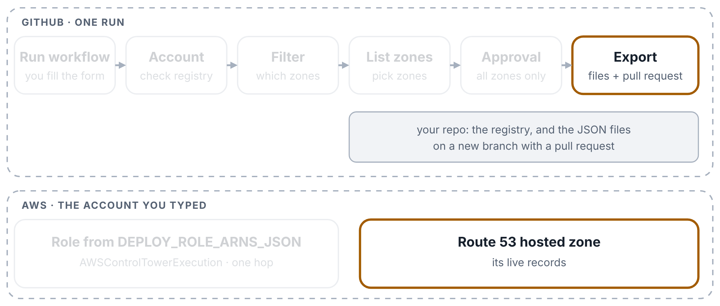
Export: one zone
WS2 DNS PIPELINES EXPLAINED
Step 7 of 9
Exporting one zone, named by its hosted zone ID. Top: GitHub and your repo. Bottom: the AWS account you typed.
The live records become a JSON file
dns_records_export.py reads the zone’s live records and writes config/accounts/<account>/networking/<stack_id>.json. ALIAS records, the SOA record and the zone’s own NS records are left out.

Slide 52
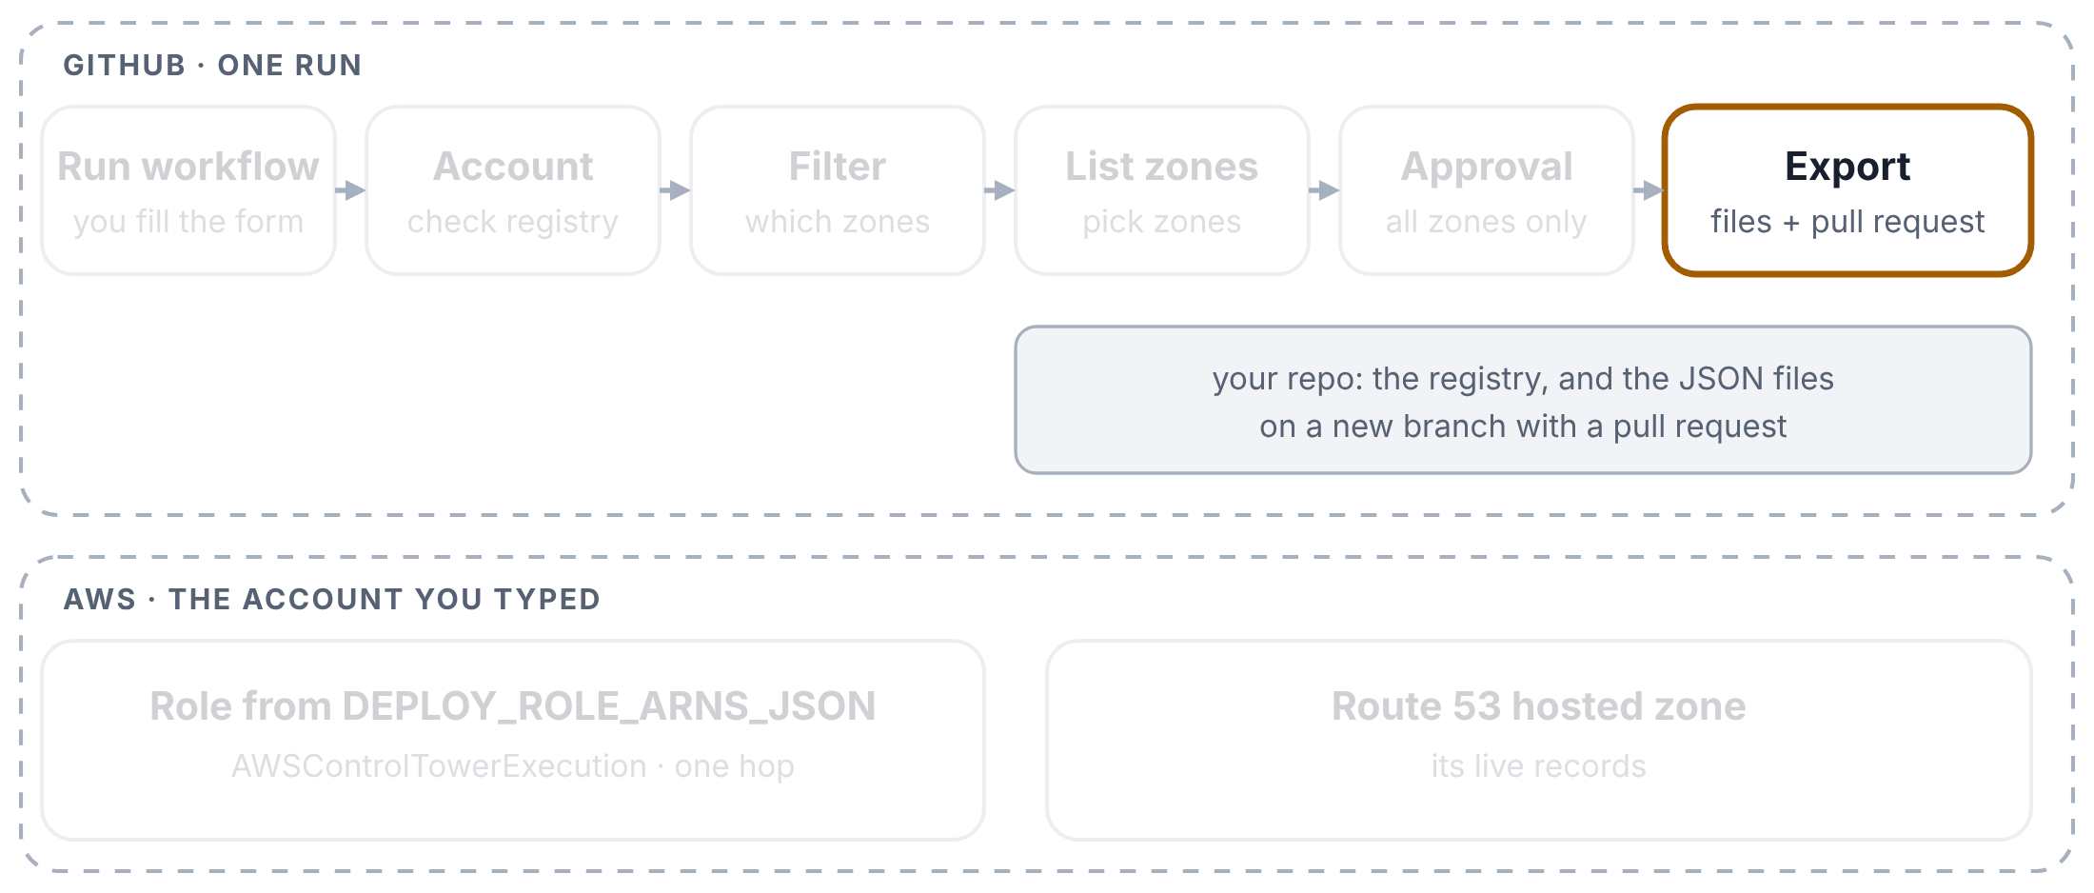
Export: one zone
WS2 DNS PIPELINES EXPLAINED
Step 8 of 9
Exporting one zone, named by its hosted zone ID. Top: GitHub and your repo. Bottom: the AWS account you typed.
A branch and a pull request
It commits the file to a new branch and opens a pull request into main, so the team can review it. The files are also kept on the run page for 30 days.

Slide 53
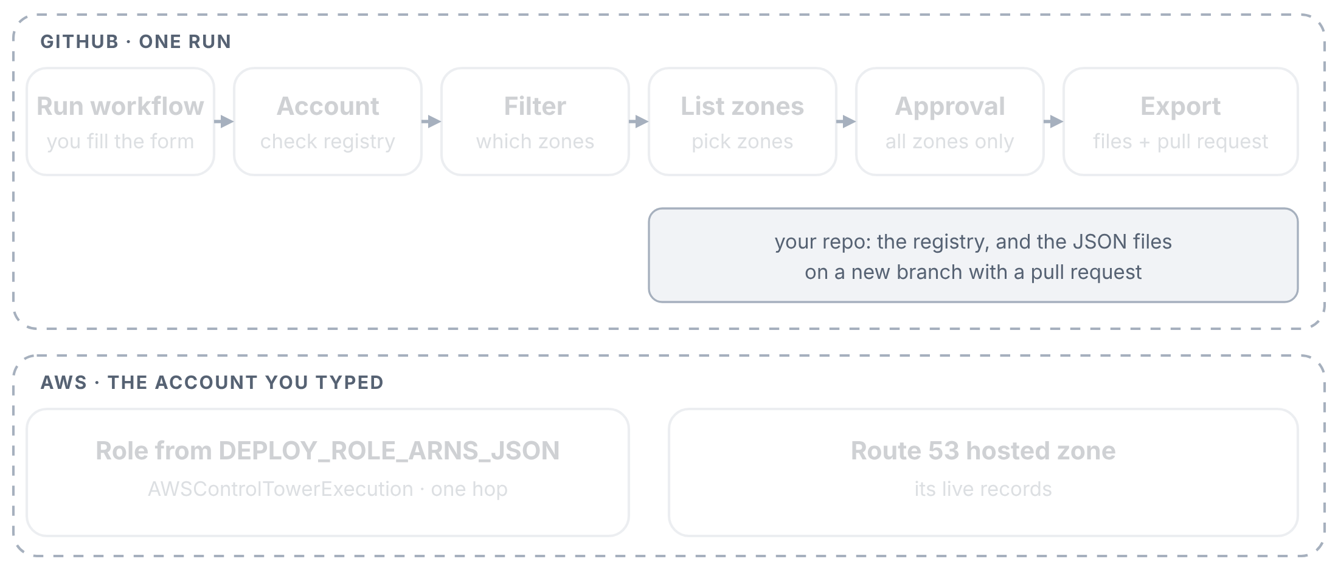
Export: one zone
WS2 DNS PIPELINES EXPLAINED
Step 9 of 9
Exporting one zone, named by its hosted zone ID. Top: GitHub and your repo. Bottom: the AWS account you typed.
What you do next
To change records, edit the file in the pull request and merge it. Then run the Apply pipeline for the same zone to put the change live.

Slide 54
Export: all zones
WS2 DNS PIPELINES EXPLAINED
Step 1 of 5
Exporting every zone of an account other than sandbox: the approval box waits for a reviewer.
You leave the zone empty
Type only the account. With no stack_id and no zone ID, the pipeline exports every zone in that account.

Slide 55
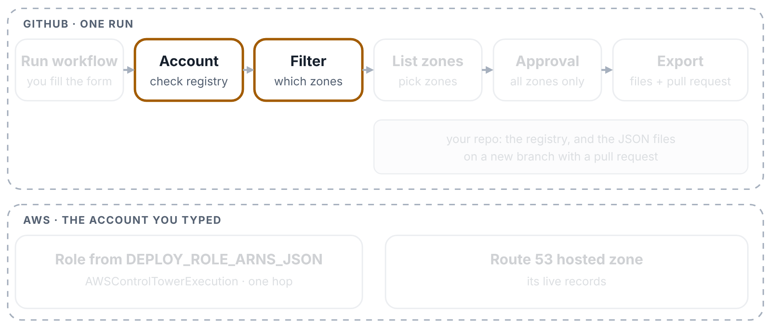
Export: all zones
WS2 DNS PIPELINES EXPLAINED
Step 2 of 5
Exporting every zone of an account other than sandbox: the approval box waits for a reviewer.
“All” mode
After the account check, the second box sees that neither field is filled in and switches to all mode. It doesn’t need AWS for that.

Slide 56
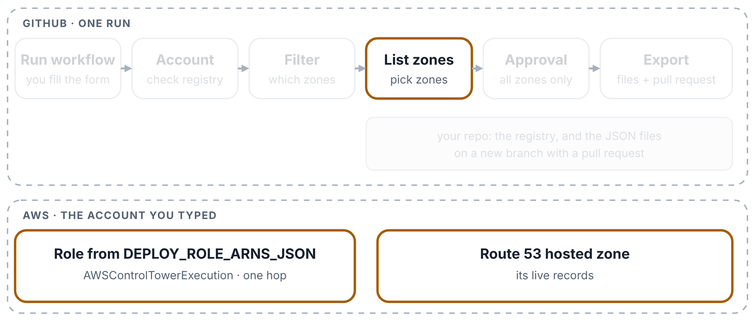
Export: all zones
WS2 DNS PIPELINES EXPLAINED
Step 3 of 5
Exporting every zone of an account other than sandbox: the approval box waits for a reviewer.
Every zone gets a name
List zones signs in and names every zone. A public and a private zone with the same name (split-horizon) get code class="nw">-public and code class="nw">-private endings, so both are exported.

Slide 57
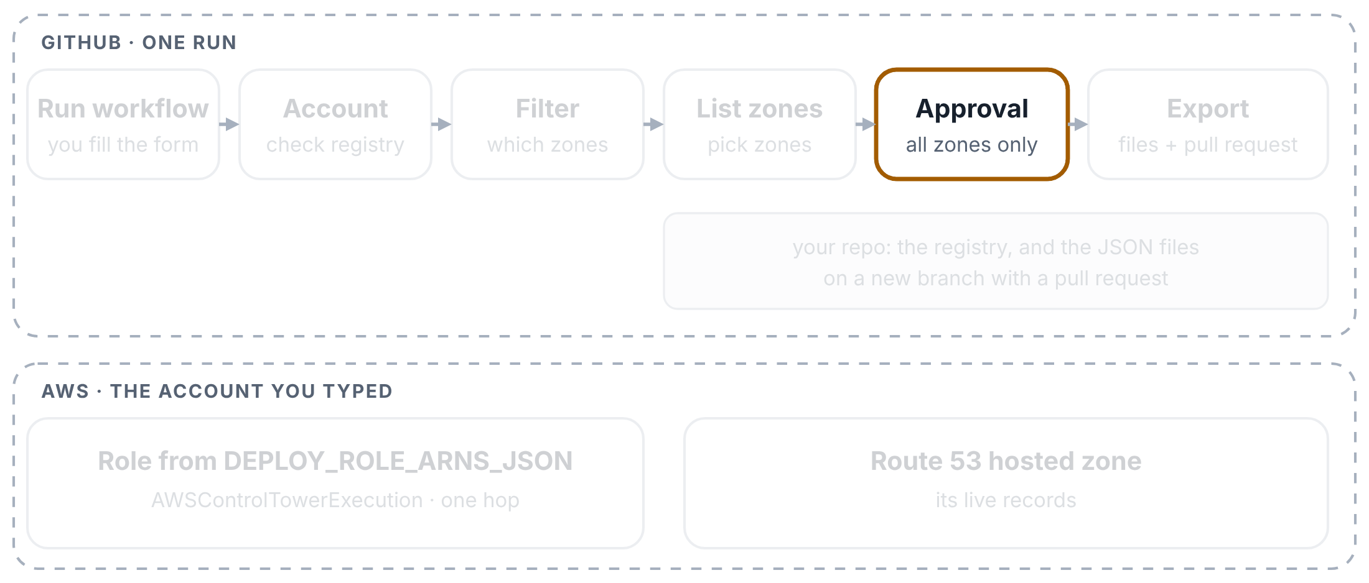
Export: all zones
WS2 DNS PIPELINES EXPLAINED
Step 4 of 5
Exporting every zone of an account other than sandbox: the approval box waits for a reviewer.
Someone approves
For any account except sandbox, the approval box waits for a reviewer of the production environment. They should read the zone list in the List zones log first.

Slide 58
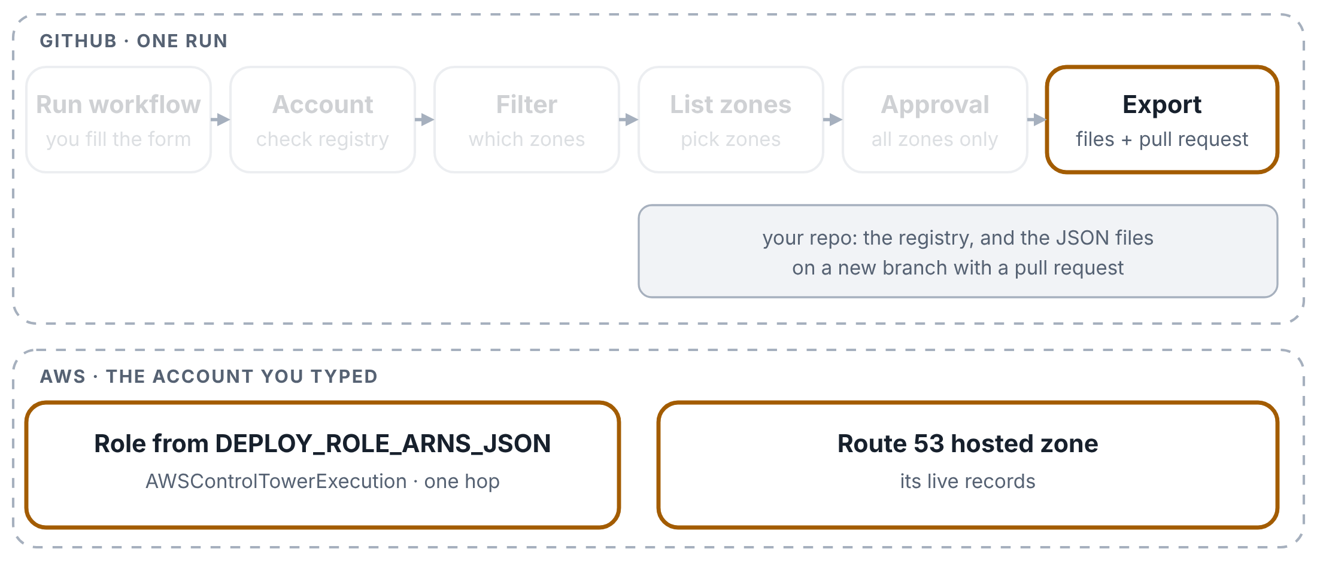
Export: all zones
WS2 DNS PIPELINES EXPLAINED
Step 5 of 5
Exporting every zone of an account other than sandbox: the approval box waits for a reviewer.
Export runs for every zone
Once approved, Export writes one file per zone, counts the exported, skipped and failed zones, and opens one pull request with all of them.

Slide 59
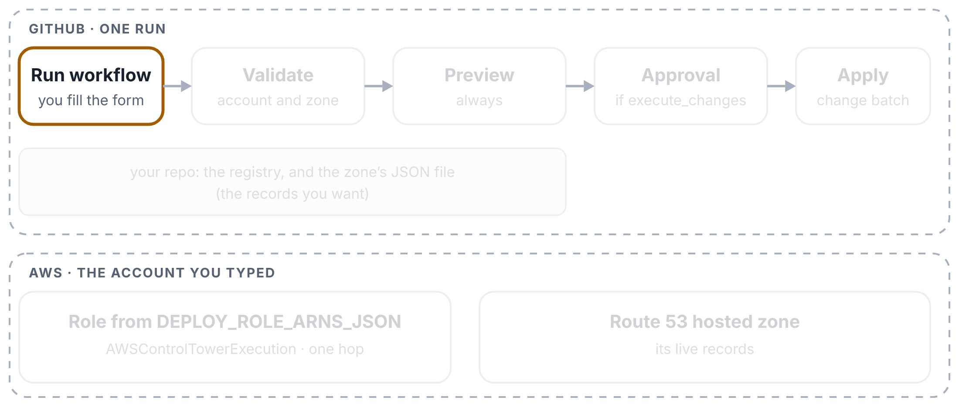
Apply: preview only
WS2 DNS PIPELINES EXPLAINED
Step 1 of 4
A preview-only run: nothing in Route 53 changes.
You start the run
Actions tab → WS2 -- DNS Records Apply (Gated / Audited) → Run workflow. Type the account and name one zone. Leave both tick boxes empty: this run only previews.

Slide 60
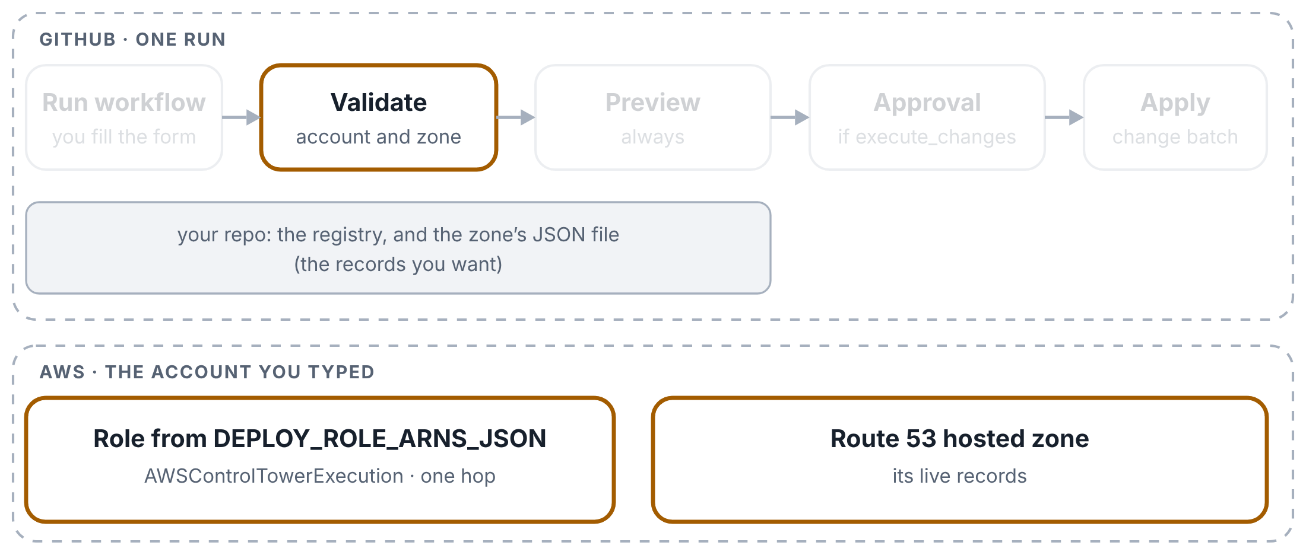
Apply: preview only
WS2 DNS PIPELINES EXPLAINED
Step 2 of 4
A preview-only run: nothing in Route 53 changes.
The account and the zone are checked
The first box checks the account against the registry, signs in the old way, and works out the zone. With no zone named, it stops: one zone per run.

Slide 61
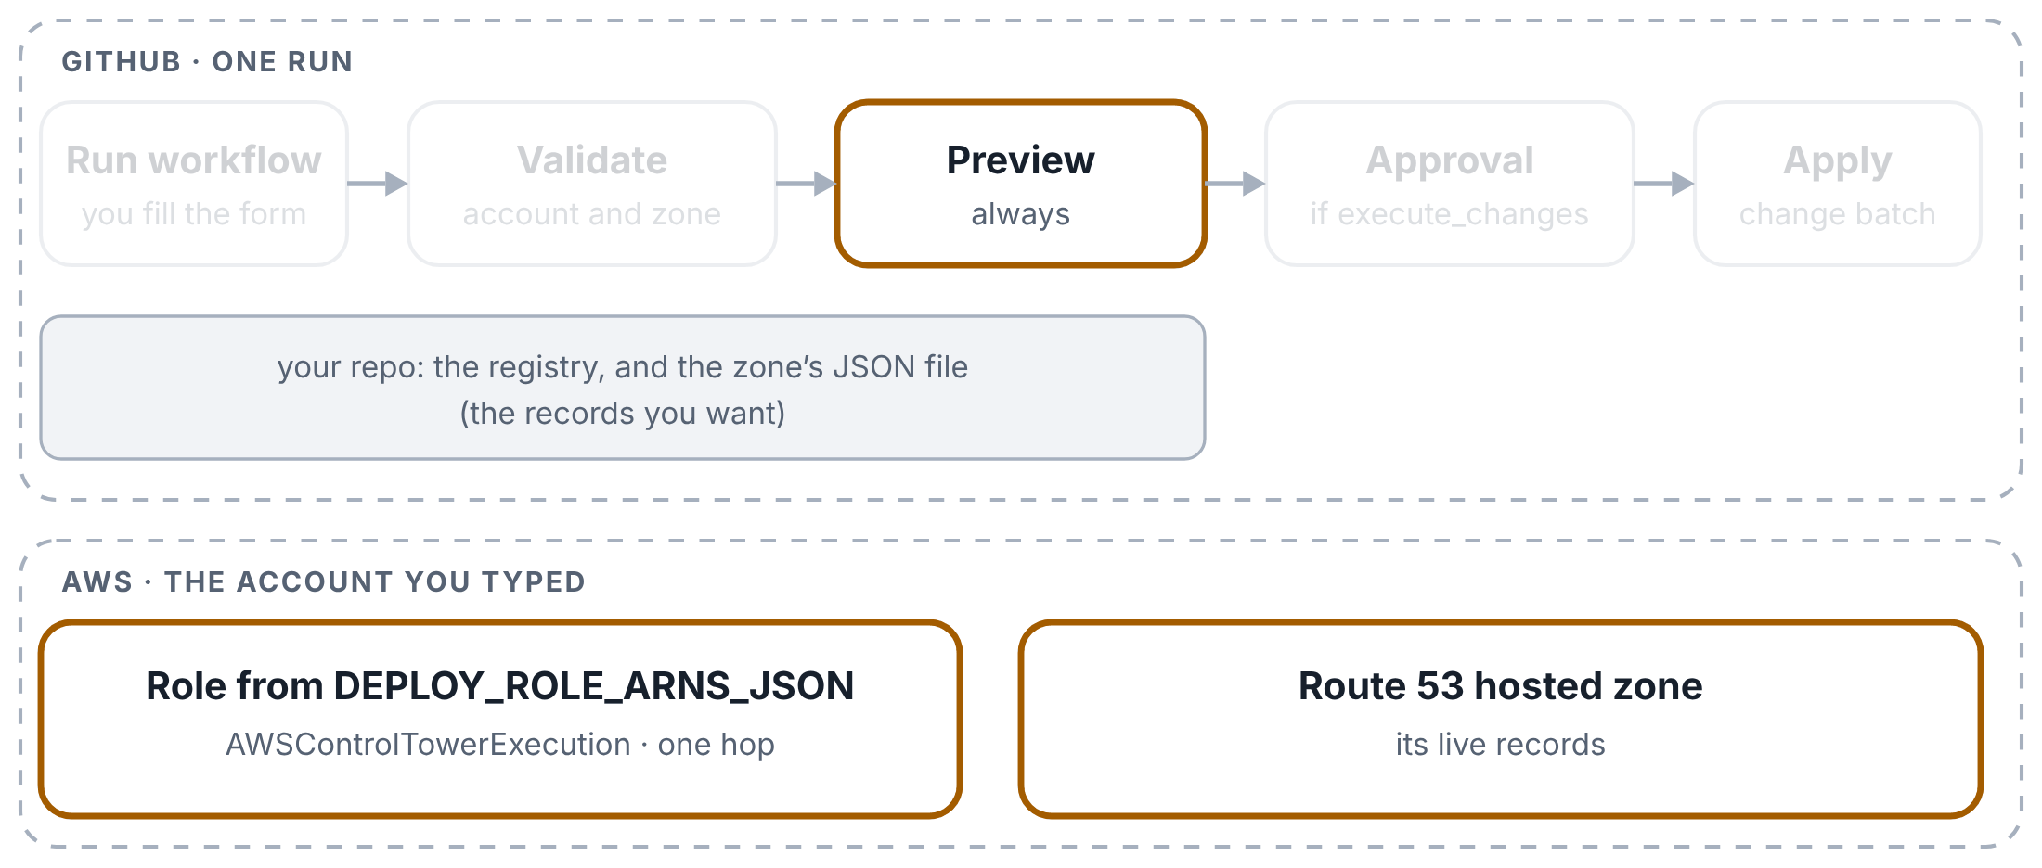
Apply: preview only
WS2 DNS PIPELINES EXPLAINED
Step 3 of 4
A preview-only run: nothing in Route 53 changes.
Preview
The second box signs in again and runs dns_records_apply.py without --execute: it compares the JSON file on the branch you ran with the live zone and prints every change it would make. Nothing changes.

Slide 62
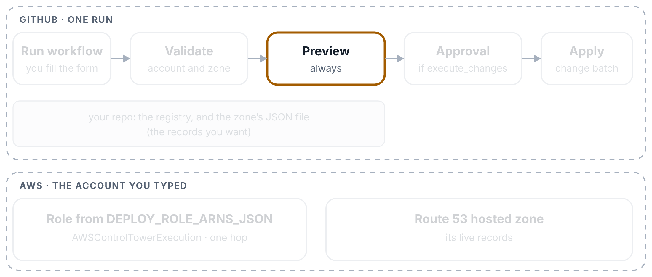
Apply: preview only
WS2 DNS PIPELINES EXPLAINED
Step 4 of 4
A preview-only run: nothing in Route 53 changes.
The run ends
Approval and Apply are grey, because execute_changes wasn’t ticked. The preview is on the Summary page.

Slide 63
Apply: with approval
WS2 DNS PIPELINES EXPLAINED
Step 1 of 5
A run with execute_changes ticked: preview, approval, then the change batch.
You tick execute_changes
The same form, with execute_changes ticked. Tick with_deletes as well only if records you removed from the file should be deleted.

Slide 64
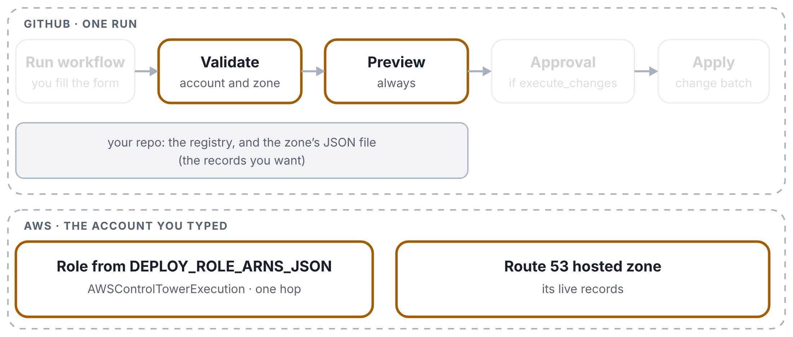
Apply: with approval
WS2 DNS PIPELINES EXPLAINED
Step 2 of 5
A run with execute_changes ticked: preview, approval, then the change batch.
Checks and the preview first
The first two boxes run exactly as in a preview-only run, so the planned changes are on the Summary page before anyone approves.

Slide 65
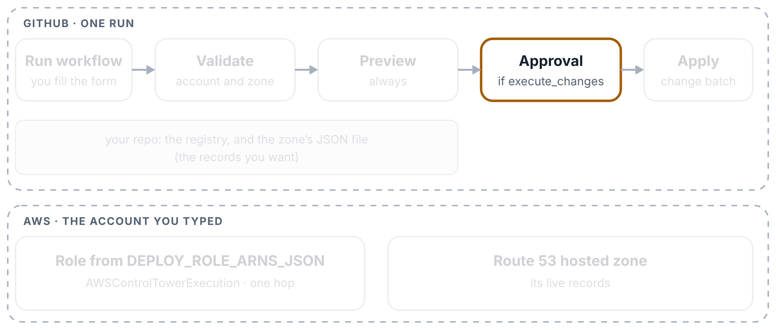
Apply: with approval
WS2 DNS PIPELINES EXPLAINED
Step 3 of 5
A run with execute_changes ticked: preview, approval, then the change batch.
Someone approves
For any account except sandbox, the run waits for a reviewer of the production environment. Sandbox goes straight on.

Slide 66

Apply: with approval
WS2 DNS PIPELINES EXPLAINED
Step 4 of 5
A run with execute_changes ticked: preview, approval, then the change batch.
Apply
The last box signs in once more and runs the same script with --execute: Route 53 makes the changes (UPSERT, and DELETE if you allowed it).

Slide 67

Apply: with approval
WS2 DNS PIPELINES EXPLAINED
Step 5 of 5
A run with execute_changes ticked: preview, approval, then the change batch.
The result
APPLIED or FAILED goes on the Summary page with the script’s output. A failure turns the box red.

Slide 68
Three Ways Into AWS
4
PART 4 OF 4
What all three share · Way 1 · Way 2 · Way 3 · What AWS recommends
Picture key: building = AWS account · badge = role · guest list = trust policy · rooms = permissions · building rules = guardrails

Slide 69

What all three ways share
THREE WAYS INTO AWS
Step 1 of 3
The part all three ways share: a signed note in, a temporary badge out.
GitHub gives a signed note
Each run gets a fresh signed note from GitHub, for this run only.

Slide 70

What all three ways share
THREE WAYS INTO AWS
Step 2 of 3
The part all three ways share: a signed note in, a temporary badge out.
AWS checks it
AWS checks the note against the guest list of one badge.

Slide 71

What all three ways share
THREE WAYS INTO AWS
Step 3 of 3
The part all three ways share: a signed note in, a temporary badge out.
A temporary badge
If the note passes, AWS hands over a temporary badge. It expires on its own, and no password is stored anywhere.

Slide 72

Way 1 · Old secrets
THREE WAYS INTO AWS
Step 1 of 6
Way 1 in the prd network account, as the old pipelines use it.
A run starts
Every run gets a fresh signed note from GitHub. The note says which repo and branch the run comes from. Nothing like a password is stored.

Slide 73

Way 1 · Old secrets
THREE WAYS INTO AWS
Step 2 of 6
Way 1 in the prd network account, as the old pipelines use it.
A secret names the badge
A secret in GitHub holds the full name of the badge to ask for. 17 of your 19 old role secrets name the same badge: the master key.

Slide 74

Way 1 · Old secrets
THREE WAYS INTO AWS
Step 3 of 6
Way 1 in the prd network account, as the old pipelines use it.
The note is checked against the guest list
The prd network account compares the note with the master key’s guest list. The list lets in the Landing-Zone repo, but also any repo in the github.com tescoims org, on any branch.

Slide 75

Way 1 · Old secrets
THREE WAYS INTO AWS
Step 4 of 6
Way 1 in the prd network account, as the old pipelines use it.
The run gets the master key
The badge it receives is AWSControlTowerExecution, Control Tower’s own key for setting up every account. GitHub was added to this key’s guest list so that pipelines could use it.

Slide 76

Way 1 · Old secrets
THREE WAYS INTO AWS
Step 5 of 6
Way 1 in the prd network account, as the old pipelines use it.
The building rules let it through
The organization’s safety rules (guardrails) are written with an exception for this key. A mistake made with it is not stopped by them.

Slide 77

Way 1 · Old secrets
THREE WAYS INTO AWS
Step 6 of 6
Way 1 in the prd network account, as the old pipelines use it.
It can open every room
The master key is full admin. A run holding it can change anything in the account.

Slide 78

Way 2 · WS2 list
THREE WAYS INTO AWS
Step 1 of 4
Way 2, as the WS2 DNS pipelines use it. Checked on 31 October 2026: both list entries are the master key.
A run starts and reads a list
Like Way 1, the run gets a signed note from GitHub. One secret, DEPLOY_ROLE_ARNS_JSON, holds a list: for each account name, the full name of a badge. The run picks the line for the account you typed.

Slide 79

Way 2 · WS2 list
THREE WAYS INTO AWS
Step 2 of 4
Way 2, as the WS2 DNS pipelines use it. Checked on 31 October 2026: both list entries are the master key.
Straight to that badge
It shows the note at that account’s door and gets the badge in one step. The check on 31 October showed which badge that is: both entries, sandbox and network-prod, name AWSControlTowerExecution, Control Tower’s master key.

Slide 80

Way 2 · WS2 list
THREE WAYS INTO AWS
Step 3 of 4
Way 2, as the WS2 DNS pipelines use it. Checked on 31 October 2026: both list entries are the master key.
The building rules let it through
As in Way 1, the organization’s safety rules make an exception for this key. A mistake made with it is not stopped by them.

Slide 81

Way 2 · WS2 list
THREE WAYS INTO AWS
Step 4 of 4
Way 2, as the WS2 DNS pipelines use it. Checked on 31 October 2026: both list entries are the master key.
It can open every room
The master key is full admin, so Export and Apply can change anything in both accounts, not only DNS records.

Slide 82

Way 3 · New IMS sign-in
THREE WAYS INTO AWS
Step 1 of 7
Way 3, the new IMS sign-in your converted pipelines use.
A run starts, with nothing stored
The run gets its signed note from GitHub. It works out the badge name from the account name, so no secret is needed.

Slide 83

Way 3 · New IMS sign-in
THREE WAYS INTO AWS
Step 2 of 7
Way 3, the new IMS sign-in your converted pipelines use.
Head office checks the note
The run goes to the head office account first (IMS Root). The guest list there decides who may come in: for the prd network, only 2 named repos; for the other badges, any repo in the 13 company GitHub orgs.

Slide 84

Way 3 · New IMS sign-in
THREE WAYS INTO AWS
Step 3 of 7
Way 3, the new IMS sign-in your converted pipelines use.
It gets a reception pass
This pass is good for one thing only: swapping it for the badge with the same name in one account.

Slide 85

Way 3 · New IMS sign-in
THREE WAYS INTO AWS
Step 4 of 7
Way 3, the new IMS sign-in your converted pipelines use.
It swaps the pass for a pipeline badge
In the network account the pass becomes iamr-net-prd-deploy, a badge made for pipelines. After this swap the run has at most 1 hour of access, and AWS doesn’t allow longer for a swap like this.

Slide 86

Way 3 · New IMS sign-in
THREE WAYS INTO AWS
Step 5 of 7
Way 3, the new IMS sign-in your converted pipelines use.
The building rules apply
This badge is not Control Tower’s master key, so the organization’s safety rules apply to everything it does.

Slide 87

Way 3 · New IMS sign-in
THREE WAYS INTO AWS
Step 6 of 7
Way 3, the new IMS sign-in your converted pipelines use.
It can still open every room
The pipeline badge is full admin, so it can still change anything in the account. The building rules are what limit it.

Slide 88

Way 3 · New IMS sign-in
THREE WAYS INTO AWS
Step 7 of 7
Way 3, the new IMS sign-in your converted pipelines use.
The one thing AWS would question
The reception desk sits in head office, where the organization’s safety rules don’t apply. AWS says to keep head office for running the organization only. The risk today is small, because a pass can only be swapped for one badge.

Slide 89

What AWS recommends
THREE WAYS INTO AWS
Step 1 of 5
AWS’s advice, drawn the same way: keep Way 3’s two steps and fix three things.
The same two steps as Way 3
AWS’s own GitHub example uses the same shape: a pass in one central account, then a badge in each target account.

Slide 90

What AWS recommends
THREE WAYS INTO AWS
Step 2 of 5
AWS’s advice, drawn the same way: keep Way 3’s two steps and fix three things.
Reception outside head office
The difference: the reception desk is in an ordinary account, where the organization’s safety rules apply. Head office is kept for running the organization only.

Slide 91

What AWS recommends
THREE WAYS INTO AWS
Step 3 of 5
AWS’s advice, drawn the same way: keep Way 3’s two steps and fix three things.
A guest list with exact names
Only named repos get in, and for production only runs from the production environment, which can require someone’s approval. Since February 2026 AWS can also check the repo’s permanent ID in GitHub’s note.

Slide 92

What AWS recommends
THREE WAYS INTO AWS
Step 4 of 5
AWS’s advice, drawn the same way: keep Way 3’s two steps and fix three things.
Only the rooms it needs
Each badge opens only what its pipeline needs. A DNS pipeline gets the DNS rooms, not the whole building.

Slide 93

What AWS recommends
THREE WAYS INTO AWS
Step 5 of 5
AWS’s advice, drawn the same way: keep Way 3’s two steps and fix three things.
The rules apply at every step
Both the pass and the badge sit in accounts where the organization’s safety rules apply.

